Slide 1
Build Ideas 3.17 Leaguestart
Not full builds, these are six foundations that builds can start from
Full builds can be made about 48 hours before leaguestart

Slide 2
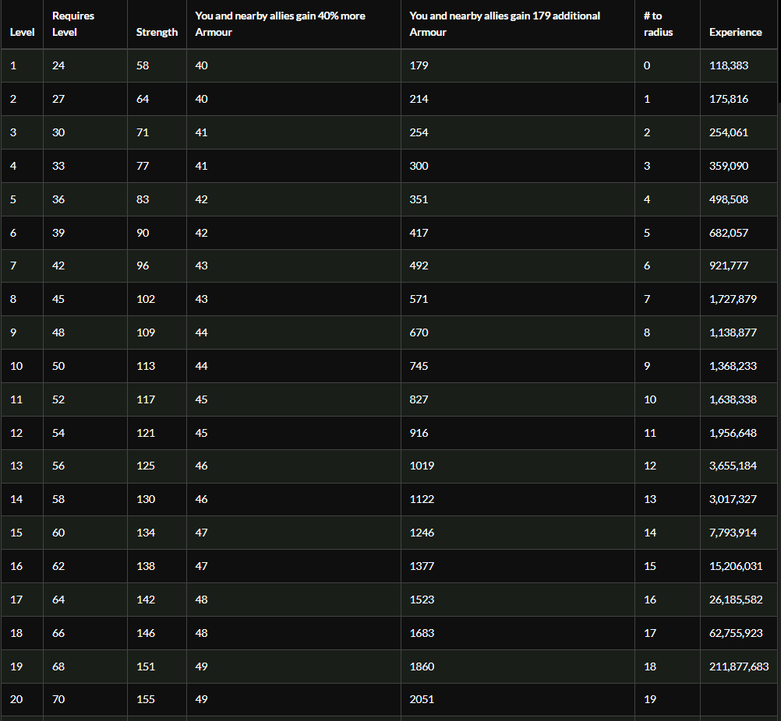
Determination. Numbers Don’t Lie. Use It.
Determination is so powerful right now in Path of Exile that every build should use it. This is partly due to armor being good, partly due to Molten Shell being amazing.
If your build doesn’t have Determination in it, pick a random aura and remove it. Repeat until you can reserve mana to also fit in Determination. Your build is now better.
Aura clusters (tree and cluster jewel) often provide more survivability than life clusters.
Grace and Defiance Banner make it better.

Slide 3
Build Around Uniques Note
There’s an amazing online resource listing community estimates of rarity tiers on unique items. (Thanks /u/PoorFishWife)
Tier 5: Achievable in trade by level 50
Tier 4: Twice as rare. Achievable in trade before your 15th map
Tier 3: 4 times rarer. Achievable in trade day 1 for powergamers, day 5 for casuals. Requires focused farming in SSF e.g. grinding Heist unique chests.
Tier 2: 4 times rarer. Think Shavronne’s Wrappings and Brass Dome.
Tier 1: 3 times rarer. Badge of the Brotherhood, Asenath gloves. This might be a casual player’s whole of league goal to acquire.
Plan accordingly! Know your limits.

Slide 4
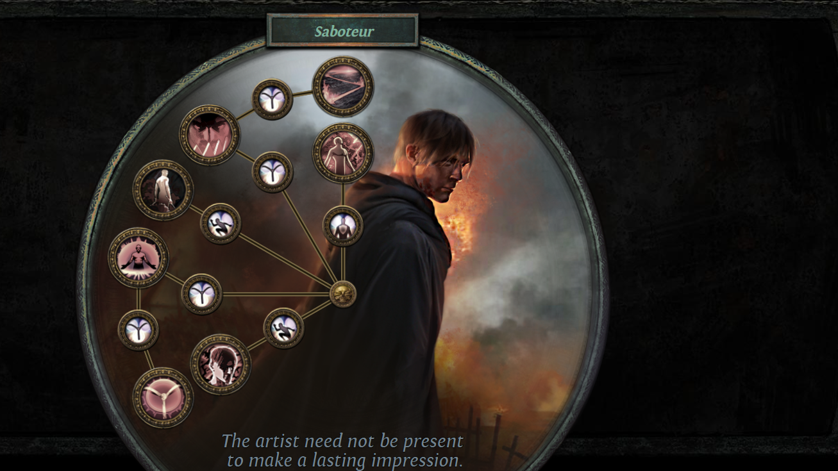
Native Trap Skill Saboteur
Ice Trap
Lightning Trap with Lightning Spire helping on bosses
Explosive Trap with Flamethrower Trap assistance
(Maybe, nerfs dependent) Seismic/Exsanguinate Traps
Crits happen. When they do, the Saboteur has already left, leaving just a pile of ruined corpses behind.
Extremely defensive playstyle alongside Grace, Determination, Defiance Banner and Spell Suppression.

Slide 5
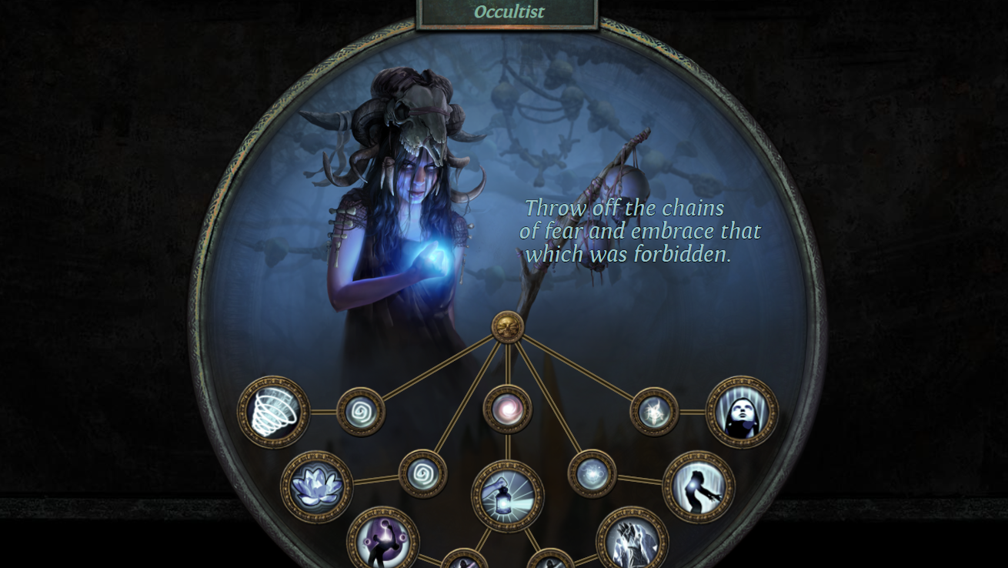
Occultist Poisonous Concoction
This build did REALLY well early in 3.16 and carried a lot of players to their first ever kills of the major endgame bosses
Not needing a weapon helps a lot with gearing
Chaos resist is surprisingly powerful defensively

Slide 6
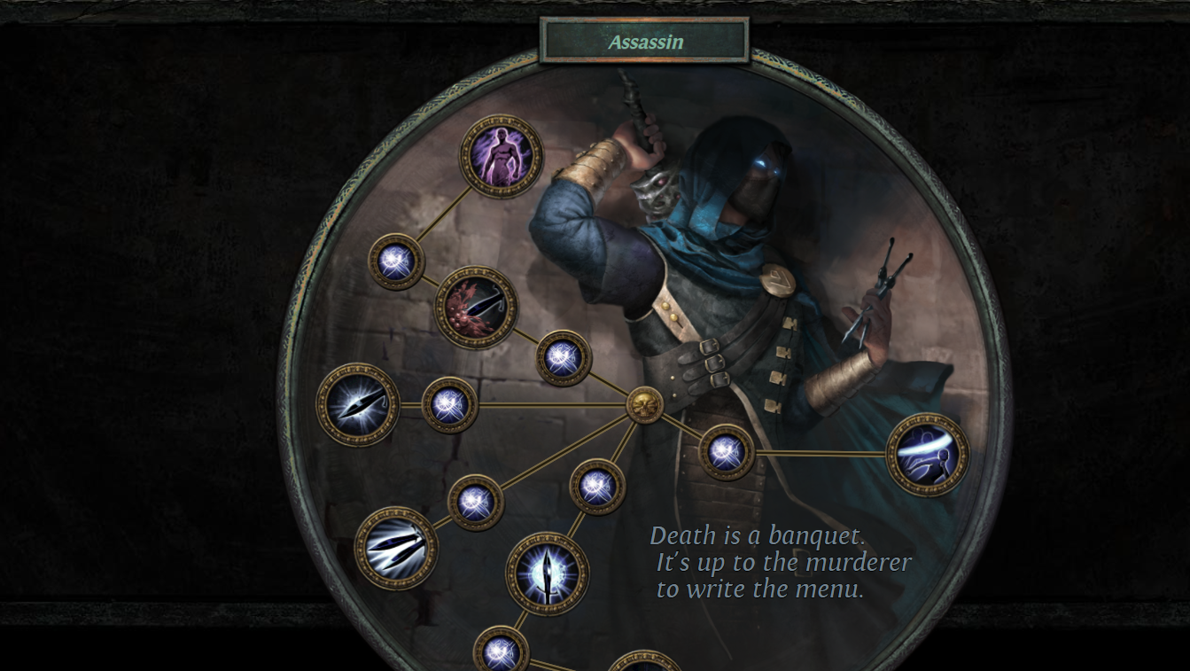
Jungroan’s Nightblade Poison Helix
Streamer Jungroan took down several trade-softcore league firsts in 3.16 (killing Sirus AL8 on a 5 link) and has been advocating this build due to Spectral Helix’s raw power, and its strong performance in dumpster tier gear in his tests.
Nightblade Support’s interaction with “Elusive has X% increased effect on you” is broken and was unexpectedly not nerfed in 3.17

Slide 7
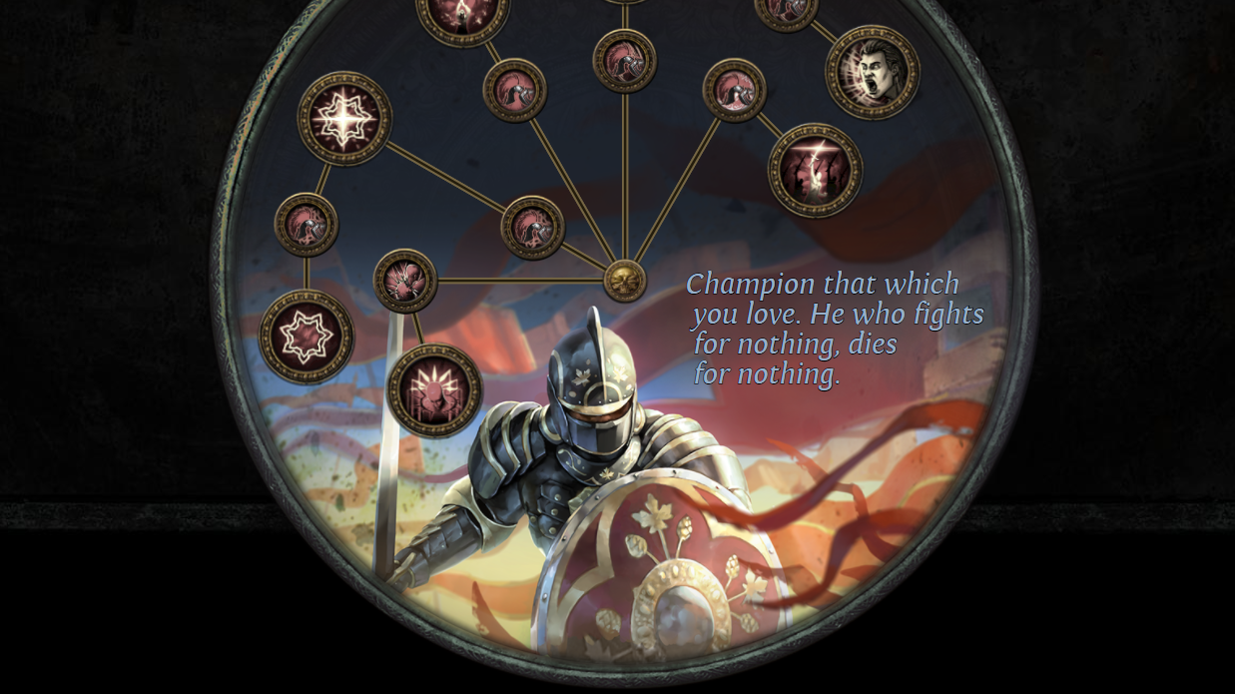
Champion Of The Bow
Champion’s “Inspirational” grants 30% aura effect and FREE Defiance Banner, making your Determination and Grace auras incredible
Fortitude adds even more durability through permanent Fortify 20
You can then choose Master of Metal for an Impale bow, or Conqueror on other builds
Don’t sleep on physical bow Impale builds, they were buffed lots. Toxic Rain survives its nerf too.

Slide 8
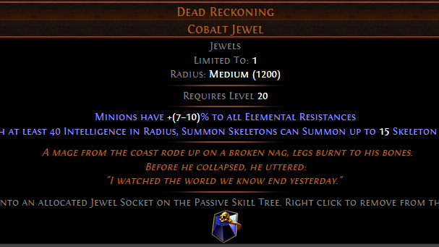
Skeleton Mages
This was really good in 3.16 at killing bosses on dumpster tier gear
However fair warning: it is ABSOLUTELY reliant upon sourcing the unique jewel Dead Reckoning, which is believed to be Tier 3 rarity
If correct this makes it the same rarity as Cold Iron Point, and 4 times rarer than Tabula Rasa, with no deterministic farming method
Expect this jewel to be 100c day 1 or 2, 50c day 3, 20c after – and have a plan (maybe Melee Skeletons) to farm.

Slide 9
Occultist Bane
I played this in Endless Delve. It’s fun, VERY tanky but does have low damage scaling limits.
It can get a lot of power out of the Chayula unique “Skin Of The Lords” with perfect rolls, alongside relatively easily crafted wands.
Probably one of the best choices if your goal is to hit level 100 but to still need help with bosses.

Slide 10
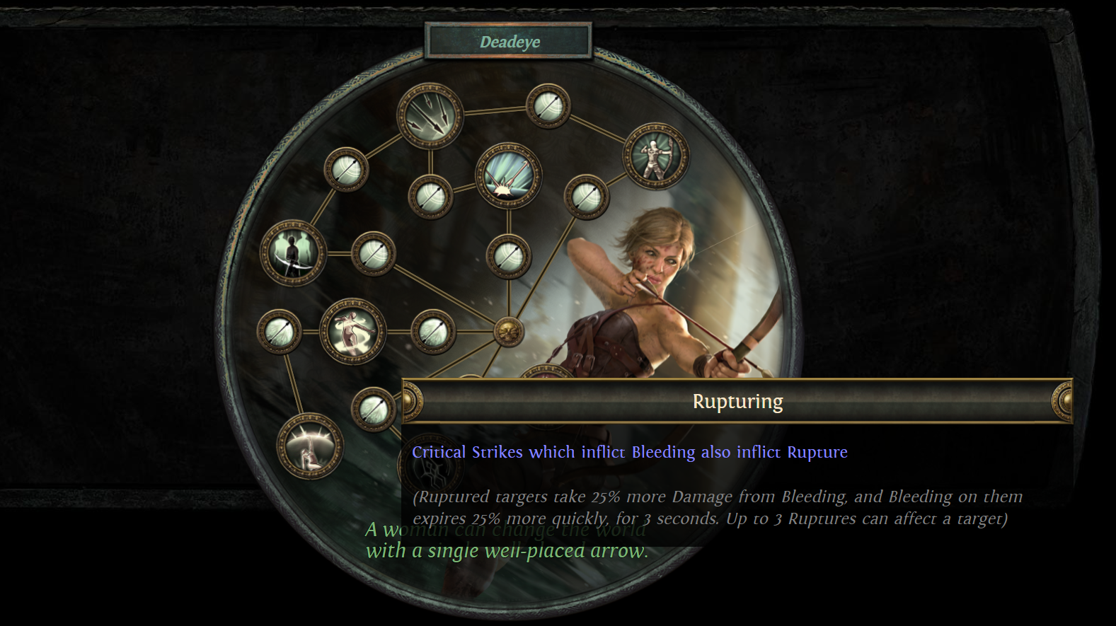
Deadeye Rupture
Deadeye’s little used Rupturing node empowers an unusual critical strike bleed build.
75% more bleed damage is great. Less duration is not, but it is manageable.
Plus it’s a Deadeye. Damage projection overload. Projectiles and chains everywhere.

