Slide 1
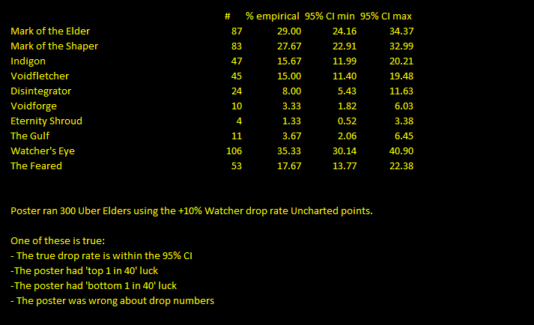
Uber Elder Drop Rates
Analysis of 300 runs by charlym
Recorded in 3.16 (Scourge)

Slide 2
Disclaimer – 300 is a small sample size
The title says it all
If you want exact, to the tenth of a percent drop rates… you’re going to need a bigger sample.
Flip a perfectly fair coin 300 times and you are 13.6% to get AT LEAST 160 heads. Roll a perfectly fair 6 sided die 300 times and you are 7.3% to get AT LEAST 60 rolls of 6
However statistics has the solution, confidence intervals

Slide 3
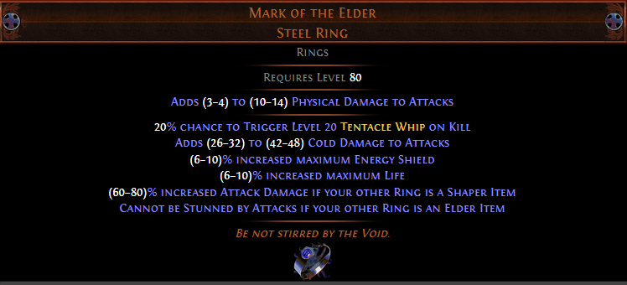
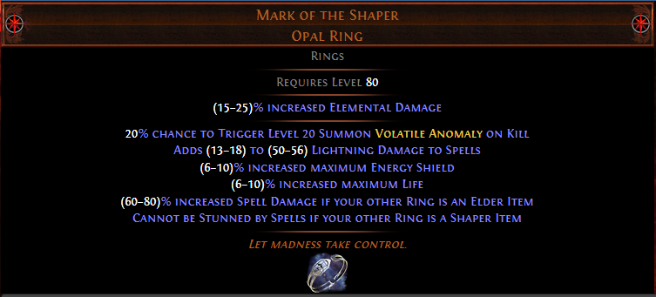
The Very Common Drops
300 runs dropped 87 Mark of the Elder and 83 Mark of the Shaper
This puts the 95% confidence interval for the drop rates at 24.16-34.37% for Elder, and 22.91-32.99% for Shaper
If we combine the two, we have 170 rings with a total 95% CI of 51.01-62.15%
Actual drop rate is probably 30% for each, but this is definitely not proven.
These items are good but not uber and way too common to hold trade value.

Slide 4
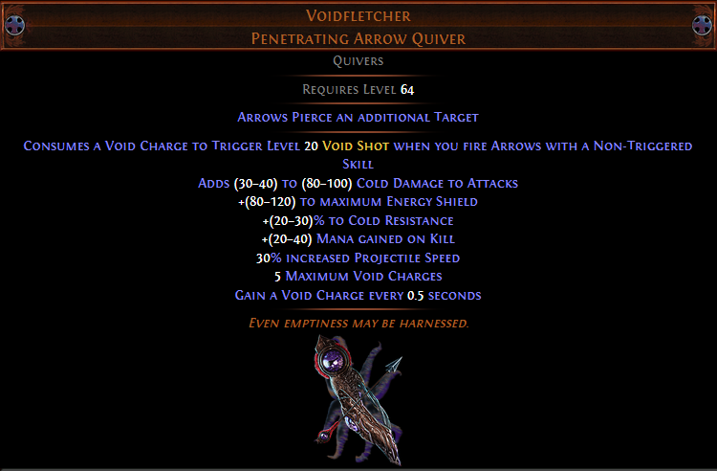
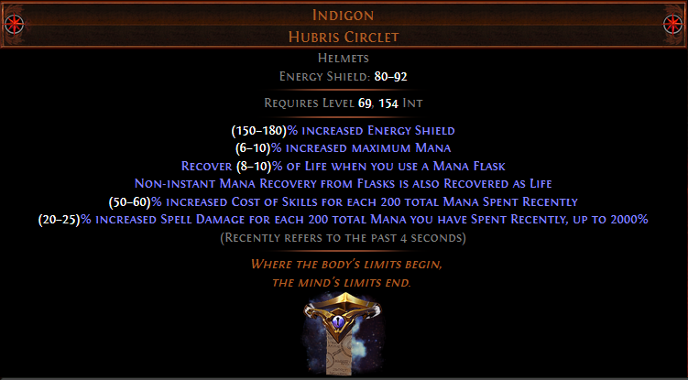
Uncommon Powerhouses
Sometimes offmeta, always good, these items are a lot of currency early league. And unlike later items they aren’t all THAT rare.
47 helms and 45 quivers from 300 indicate 15% drop rate for each is very plausible, but that is not proven.
95% CI is 11.99-20.21% (helm), 11.40-19.48 (quiver)

Slide 5
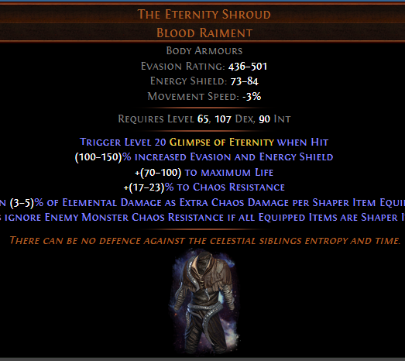
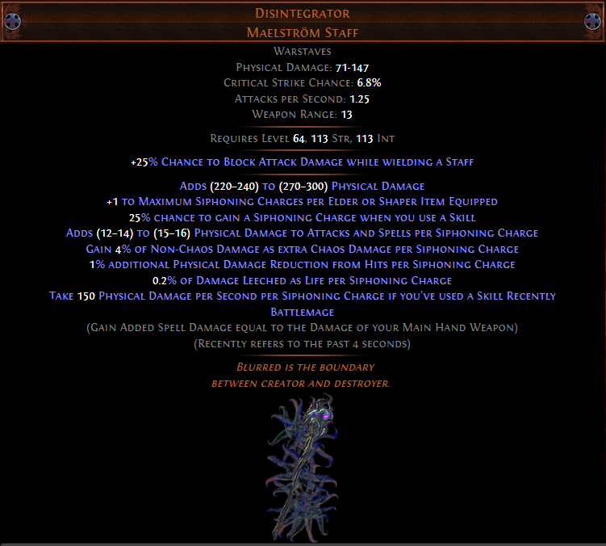
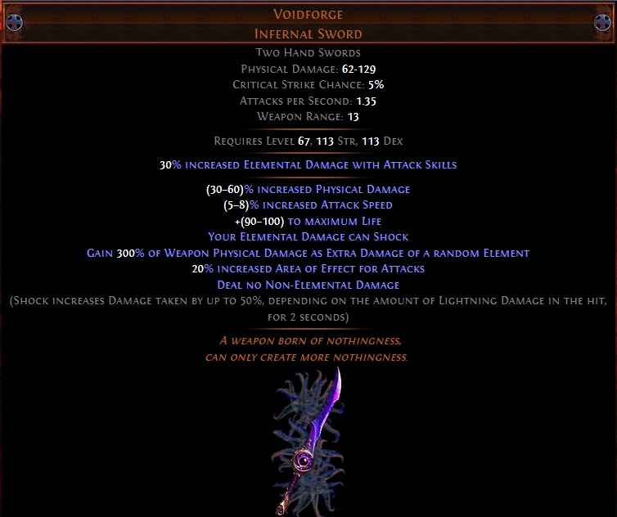
The Very Rare Niche Items
These items are well documented to be rare. Most speculate Disintegrator to be the most common, Voidforge next, then Eternity Shroud as the ultra-rare item that is no longer really chased after.
95% CI: Disint 5.43-11.63%. VF 1.82-6.03%. TES 0.52-3.38%
TLDW: don’t plan on these in SSF
Most speculate the actual drop rates to be 3, 2 and 1 in 60 respectively.

Slide 6
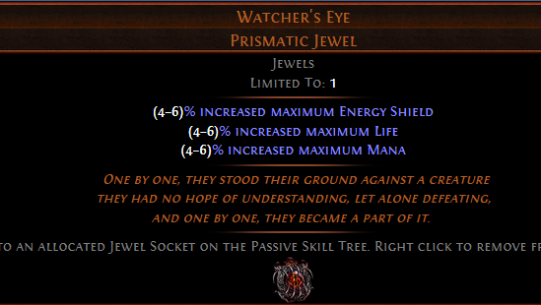
The Big Moneymaker
Watcher’s Eye is the chase unique everyone is chasing in Uber Elder
Unidentified ones often trade for upwards of five exalts. This is due to a miniscule chance of getting a combination of mods that is worth (literally) thousands of exalts.
106 from 300 runs with the +10% chance from Uncharted Realms is in line with the widely speculated 25% base chance.
95% CI is 30.14% to 40.90% on this item.
Note: ilvl 86 Eyes have three aura mods. i85 ones have two aura mods and are typically worth 60-70% less when unidentified.
When you get an Eye, it doesn’t even take up your loot slot. You’ll get another unique too.

Slide 7
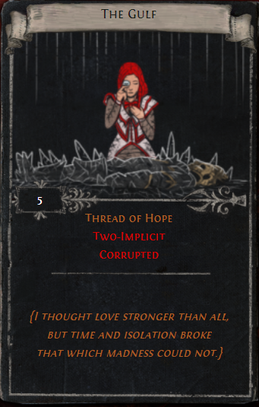
The Bonuses
The divination card The Gulf shows Zana mourning Sirus’s apparent death, prior to Sirus becoming the omnicidal nihilistic monster he is at present endgame.
It drops from Uber Elder.
It’s MUCH rarer than I suspected. 11 drops from 300 runs. That’s only two sets, and Thread of Hope is a common Sirus drop.
95% CI shows a 2.06-6.45% drop rate
There’s also Maven’s Invitation: The Feared, much more common at 53 drops (13.77-22.38%)

