Slide 1
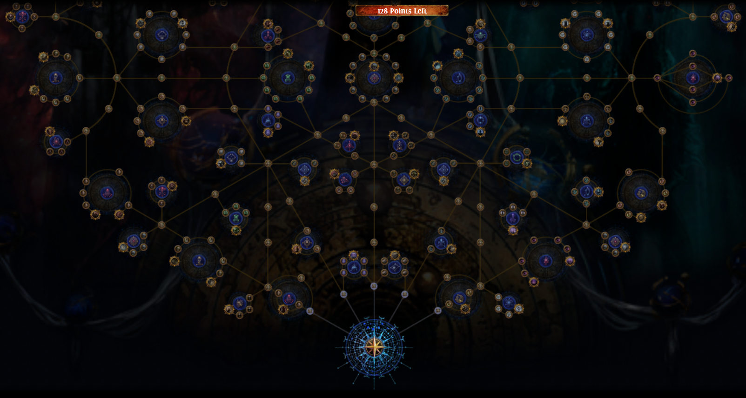

Atlas First Thoughts
Pre 3.17 preparation…

Slide 2
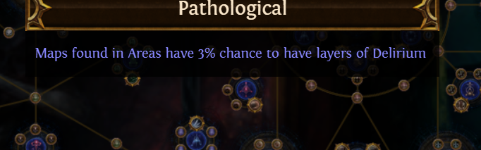
All Node Costs Are Equal… but some nodes are more equal than others
There’s a small number of nodes so good, that I don’t believe choosing not to take them can be justified on any atlas setup.
There’s a larger number that are very very good – but not universal. Some are so good every bosskilling oriented character needs them but map clearers can skip, etc.

Slide 3
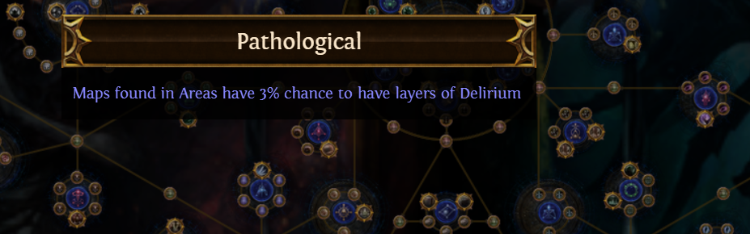
The Best Node On The Whole Tree
3% doesn’t sound like much
Until it is. If you drop 3000 maps over the league, this applies 1-5 delirium orbs to 90 of them.
Mandatory on all trees. Bosser, mapper, low tier farmer.
I’d pay 15 points for this. It costs 5.

Slide 4
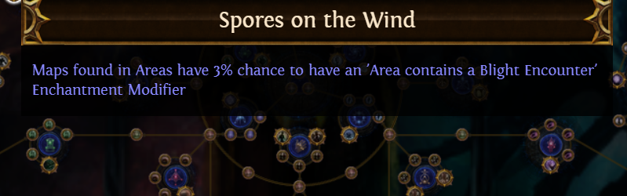
The Must Take Nodes
All mapping or bossing characters: Pathological
All characters running T14+ maps (bosser or mapper): Synthesis and Shaper/Elder clusters
All mappers: Sextant and Scarab clusters
All bossers: Maven, Exarch, Eater clusters
Recommended for mappers: Spores On The Wind
Oh how convenient, these are all near each other.

Slide 5
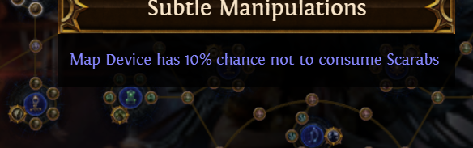
Le Scarabs Have Arrived
The Scarab cluster is so good I’d pay 12 points for it
It costs 5. Small nodes are great too.
Take it

Slide 6
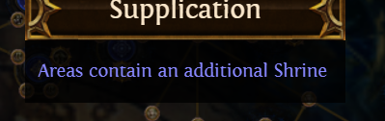
The ‘I don’t know if it is a Must Take Node’
Shrines add monsters to maps usually
Enough to justify taking this?
I’m honestly not sure. I think the answer is yes and will take this early.

Slide 7
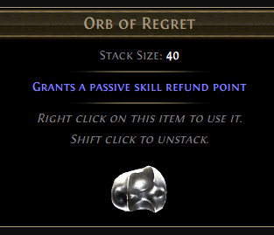
Respeccing:
1 Orb of Unmaking costs 2 Orb of Regret
(Kirac vendor exchange)
So experiment. But still take all the S tier nodes.

Slide 8
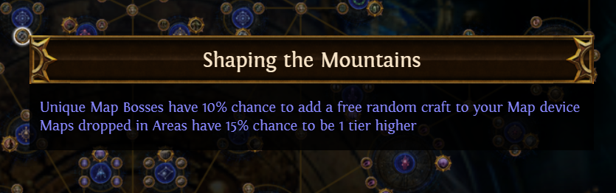
The Early Game Greats
There are nodes that add +tiers to map drops
VERY good early, you might respec out later.
So is anything (including travel nodes) with a % chance to drop an adjacent map on bosskill. Helps with filling Atlas holes.
Kirac missions also help with the holes. Great early.

Slide 9
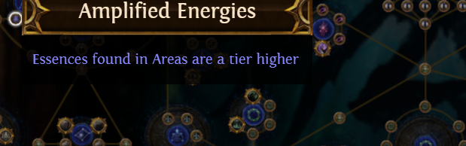
Essence
Excellent early and in SSF
Consider respeccing out later but it’s fine to keep

Slide 10
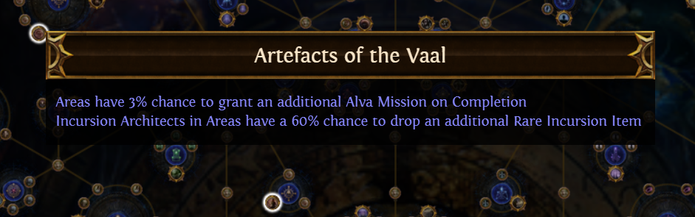
Master Missions
Two types of nodes
Mission replenish (good early)
Mission boosts (good late)
Take replenish nodes early for your favorite Master(s)
Respec into boosts when you have 20+ missions saved

Slide 11
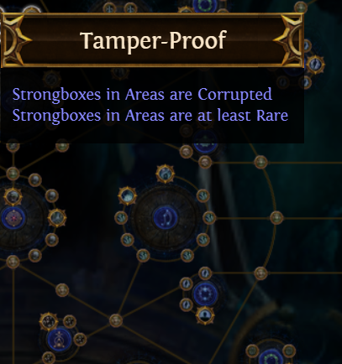
Strongbox
Excellent early & SSF
Tamper-Proof great for early six links
Secret Operations (Scarab Box) requires testing. May be S tier.

Slide 12
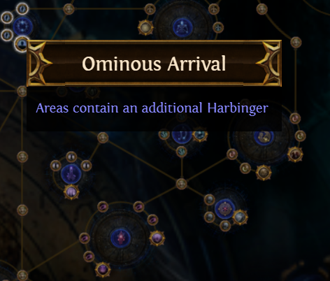
Harbinger
Just as good early game as 3.16 but with less top-end scaling (Auspicious Stones gone)
Run it only if you enjoy it.
Does work well with Beyond when we get to that.

Slide 13
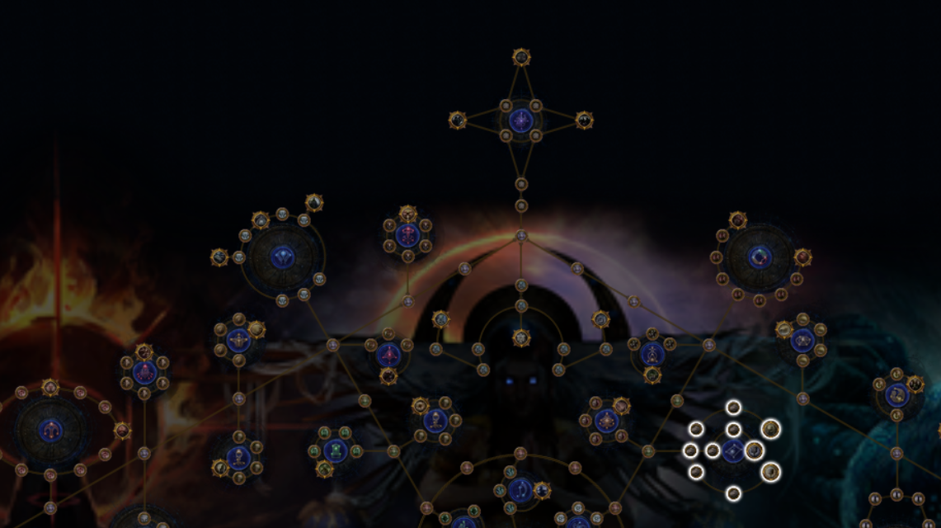
Late Game Powerhouses
Some things are hard to use early
But very, very good late, when your character is powerful enough to obliterate screens at once.

Slide 14
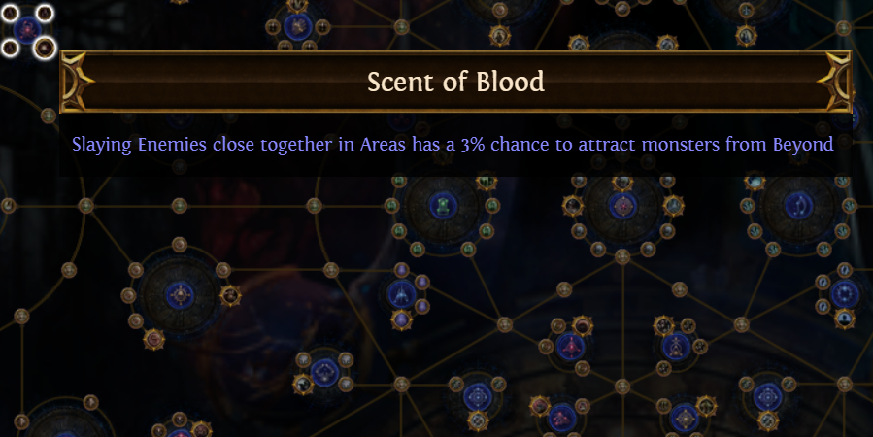
Beyond
Scent of Blood and Torn Veil do a lot together
They multiply the effects of other mods that add monsters to maps
Don’t take this early as it will make maps too hard.
Great with anything that spawns a large number of mobs in one place… how can we do that…

Slide 15
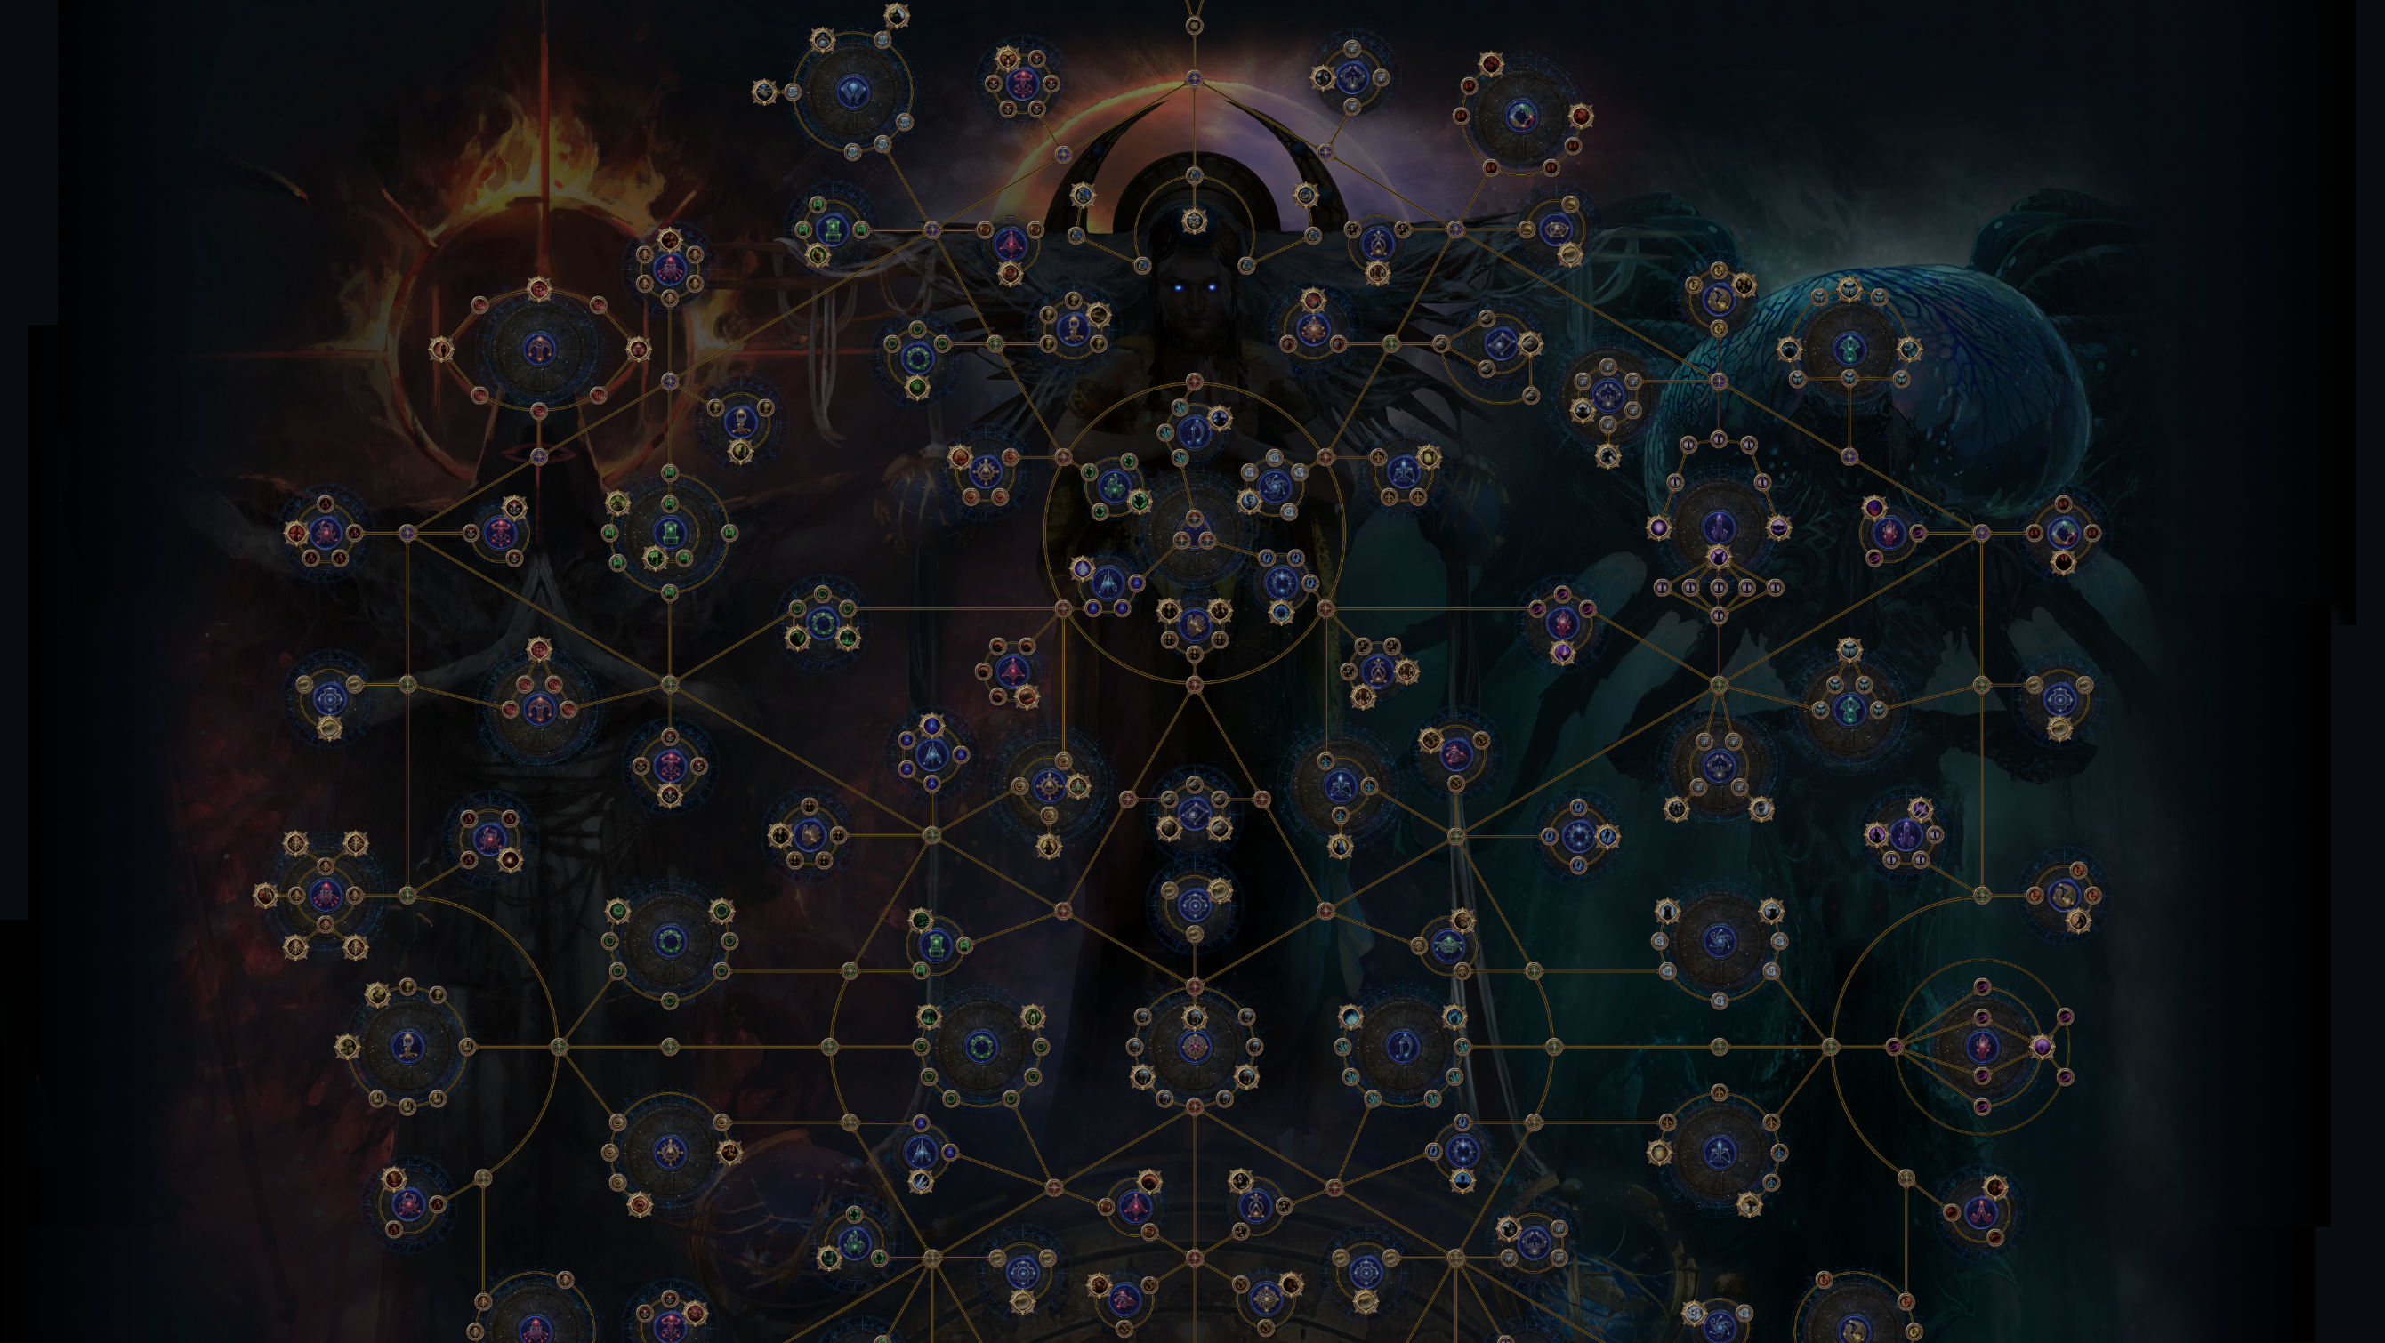
Abyss, Blight and Legion
For Abyss, I’m talking Abyssal Army (more monsters and XP from abysses), not the Abyssal Depths and Lich nodes (which are OK but not uber, take them if Abyss is fun for you).
All of these work REALLY WELL with Beyond.
All of them work even better with scarabs that allow a razor-focus on one type of content.
Abyssal Army, Torn Veil, Scent of Blood and Gilded Abyss Scarabs is quite a combo.
SSF players can’t sustain scarabs. Spec into Beyond and keep it. Spec Abyss when you have 10 Abyss Scarabs saved then unspec Abyss and do the same for Legion and Blight.
Trade players, spec Beyond + your favorite from the other three, and sustain scarabs by trading.

Slide 16
Poor Breach
In theory, same strategy works but…
The breach nodes just look weaker in comparison.
If you love Breach spec it and Beyond anyway, just expect that you’d do slightly better running Abyss, Blight or Legion in its place

Slide 17
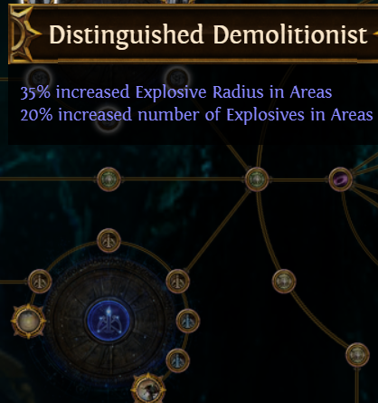
Expedition
Expedition still has solid support on the tree
Were the best nodes in 3.16 and seem just as good now
Also Rog will be better in 3.17 (not due to buffs, due to uninfluenced well-rolled items being better)

Slide 18
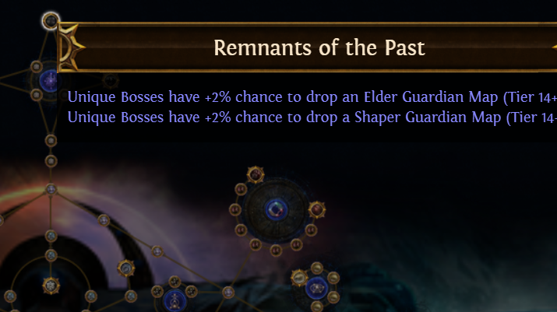
Bosskillers And Mappers, Together At Last!
Shaper and Elder maps come from this cluster at the very top.
Mappers will gain the most from it but bosskillers will want it too.
Everyone should take every node in this cluster. If you can’t beat Guardian maps – sell them in bulk to someone who can.
The Synthesis cluster is equally good and is a must-take.

Slide 19
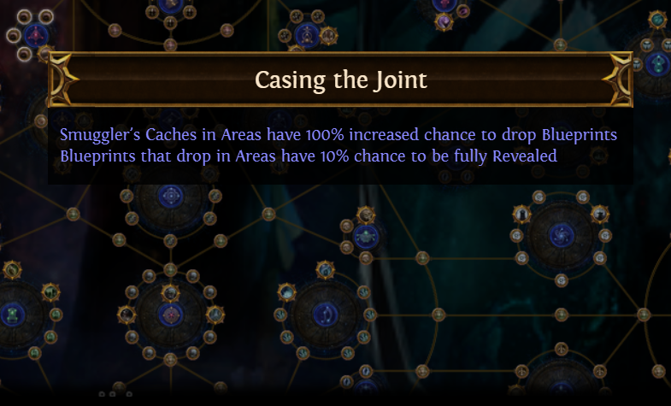
Side Content
Heist has GREAT support on the tree. Even if you don’t like Heist, consider grabbing the Heist nodes to have more blueprints and coins to sell. Every Casing the Joint proc in a higher tier map is a free exalt.
Harvest is still incredible
Metamorph doesn’t look strong. Dip into this only if you are able to source cheap Metamorph scarabs or love Metamorph
Unique Maps – not as good as you think. +2 level gives little XP.
Vaal Side Areas – This is economy based in trade. I think C tier.

Slide 20
So you REALLY hate bosses?
If you have a specialist bosskiller meet the best nodes on your Atlas
The area near the top contains the Maven, Sirus, Searing Exarch and Eater of Worlds nodes
Allocate them all

Slide 21
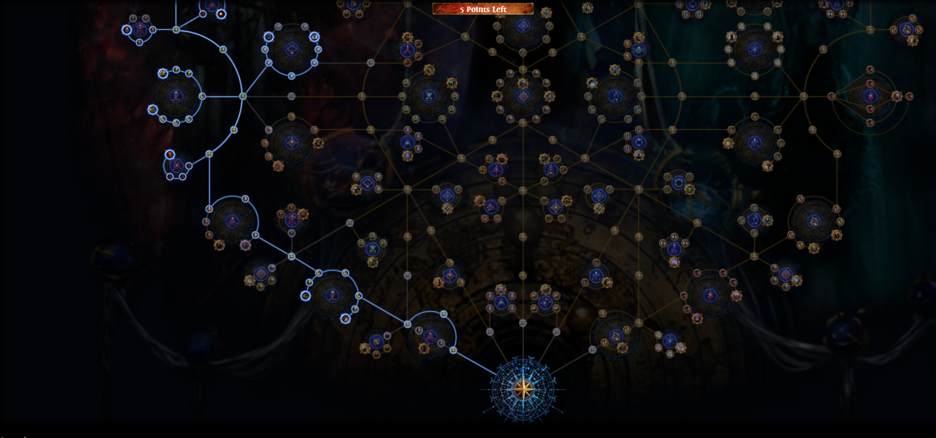
An Initial Tree – South Half
Subject to change… In map juicing from Beyond and Blight; I prefer Abyss to Blight but the pathing worked better with Blight

Slide 22
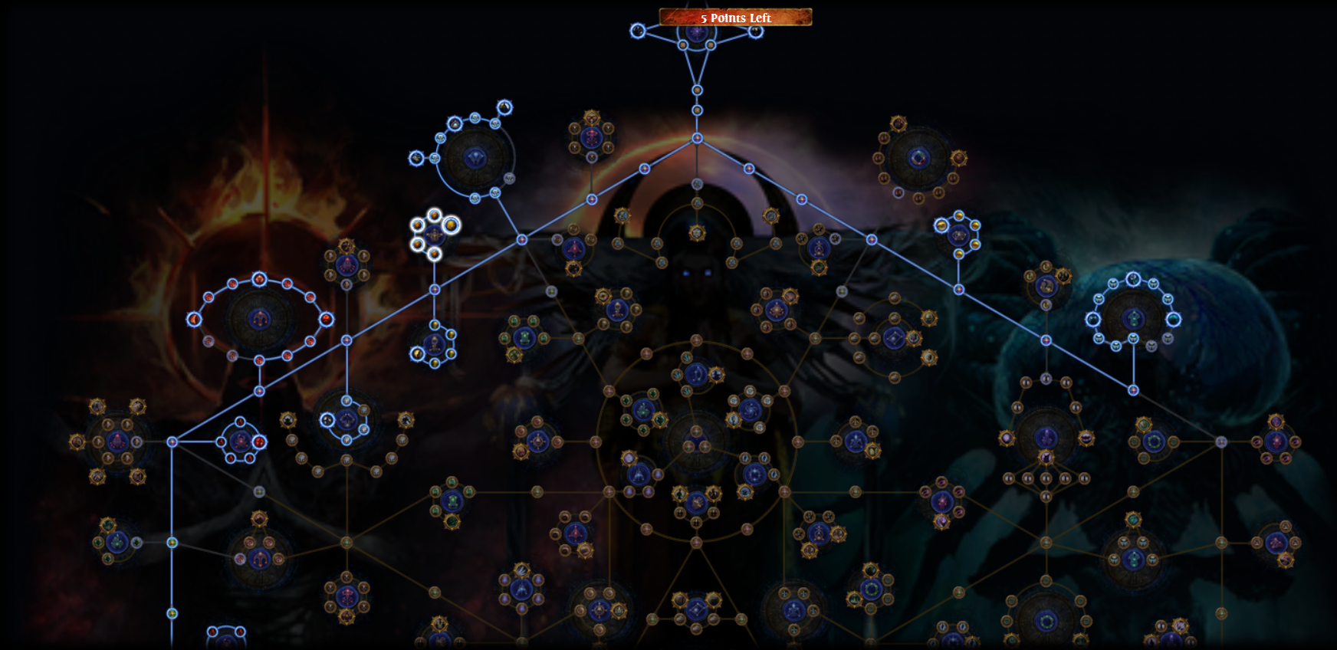
An Initial Tree – North Half
We’ll drop Exarch and Eater influence if needed for more juicing

Slide 23
Link to initial tree
tinyurl.com/2nkb5knj
No promises this is optimized! Will need to reassess.
This is oriented to fast T14-16 mapping and light bossing (Shaper/Elder and down)

