Slide 1
Build Ideas 3.17 Left Side/Centre Of Tree
Not full builds, these are foundations that builds can start from
Full builds: A great resource is Reddit’s ‘PathOfExileBuilds’ forum

Slide 2
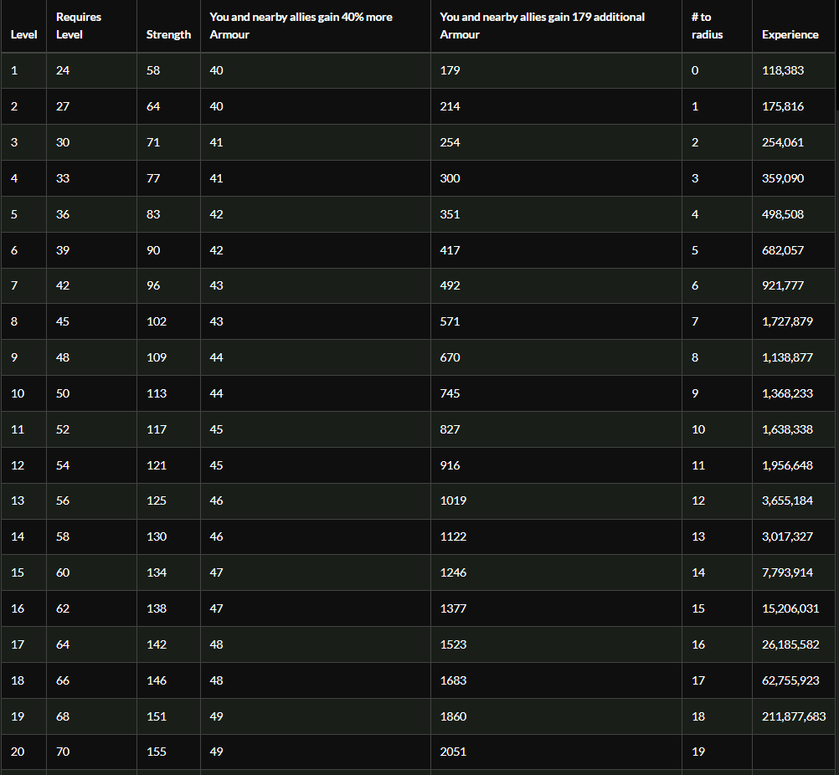
Determination. Numbers Don’t Lie. Use It.
Determination is so powerful right now in Path of Exile that every build should use it. This is partly due to armor being good, partly due to Molten Shell being amazing.
If your build doesn’t have Determination in it, pick a random aura and remove it. Repeat until you can reserve mana to also fit in Determination. Your build is now better.
Aura clusters (tree and cluster jewel) often provide more survivability than life clusters.
Grace and Defiance Banner make it better.

Slide 3
Build Around Uniques Note
There’s an amazing online resource listing community estimates of rarity tiers on unique items. (Thanks /u/PoorFishWife)
Tier 5: Achievable in trade by level 50
Tier 4: Twice as rare. Achievable in trade before your 15th map
Tier 3: 4 times rarer. Achievable in trade day 1 for powergamers, day 5 for casuals. Requires focused farming in SSF e.g. grinding Heist unique chests.
Tier 2: 4 times rarer. Think Shavronne’s Wrappings and Brass Dome.
Tier 1: 3 times rarer. Badge of the Brotherhood, Asenath gloves. This might be a casual player’s whole of league goal to acquire.
Plan accordingly! Know your limits.

Slide 4
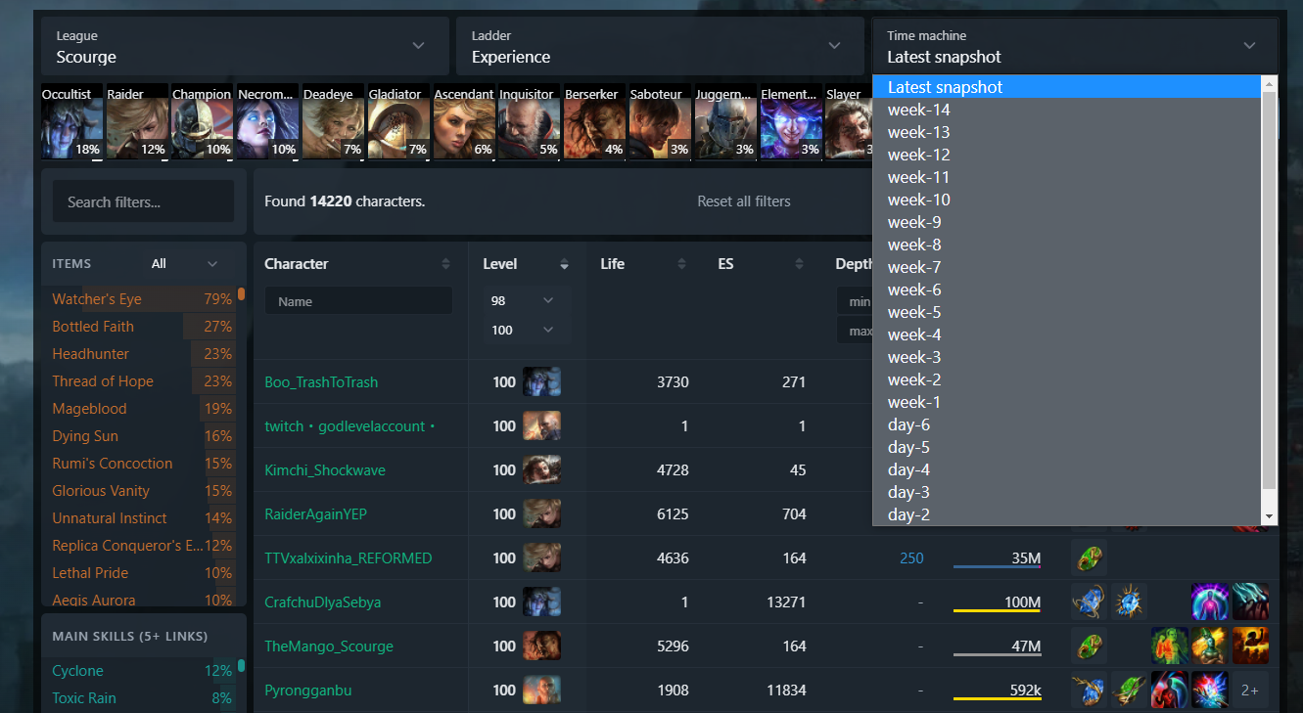
POE.Ninja – an invaluable resource
Playing something that’s mostly unchanged from 3.16?
If so, you can use poe.ninja’s Builds area and the Time Machine feature to look up builds as they existed early in Scourge league
Trade or SSF, HC or SC – you can check out both
It’s a great source of passive tree texture. I suggest checking out day 4.

Slide 5
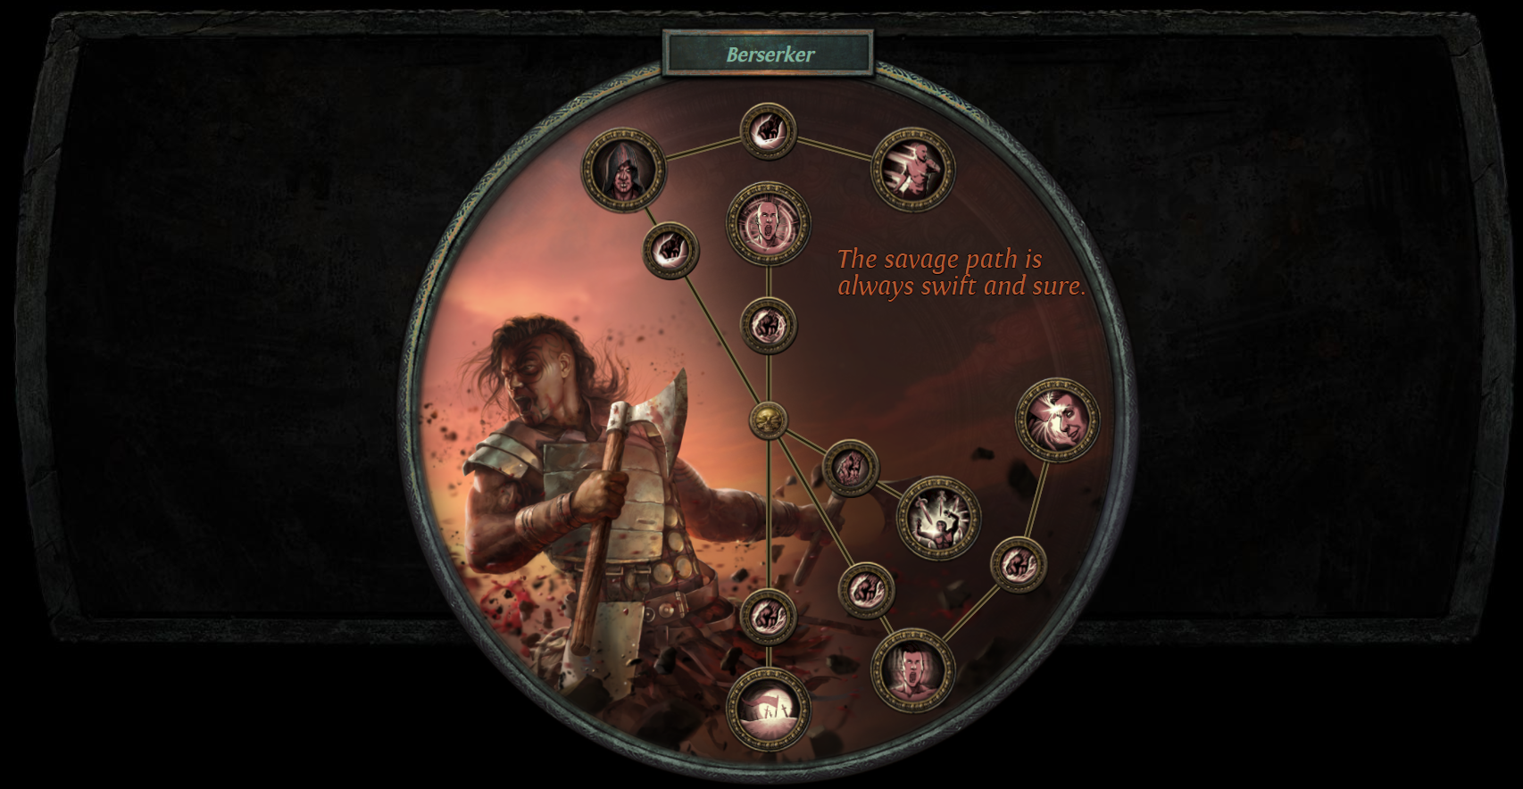
Lightning Strike Berserker
Sometimes the best defense is a good offense. Dead enemies don’t hit back.
Berserker provides incredible attack speed and damage scaling.
Streamer KobeBlackMamba has produced a guide on this, or you can check out poe.ninja’s archives for 3.16

Slide 6
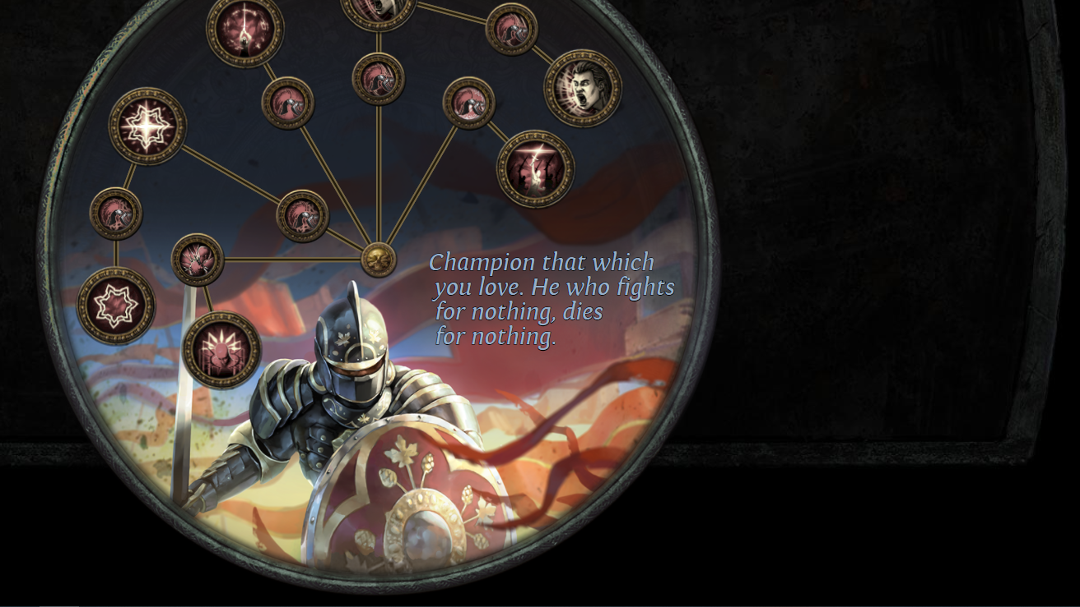
Champion Toxic Rain
The right side video covered something more experimental, Champion played as a physical damage archer.
However, Champion Toxic Rain was the second best performing build early in 3.16 and still looks excellent despite the nerfs.
Do expect to hit a damage ceiling. You are tough enough to endure against bosses but might take a while to whittle them down.

Slide 7
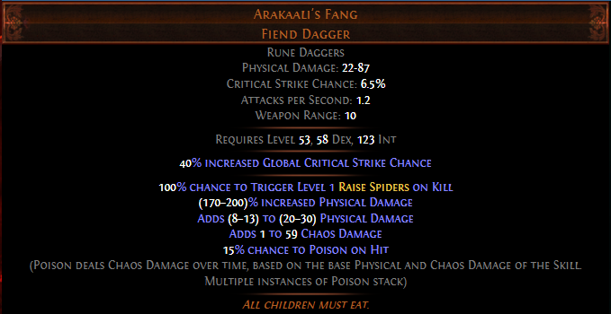
Arakaali’s Fang Minions
WARNING: This ABSOLUTELY requires a ~300c unique (based on day 4 price last league). Only you know whether this is realistic for you or not!
These spiders are little wrecking balls
Incredible top-end scaling options (The Squire) but good without them.
Can be played as Occultist, Necromancer, Guardian and more.

Slide 8
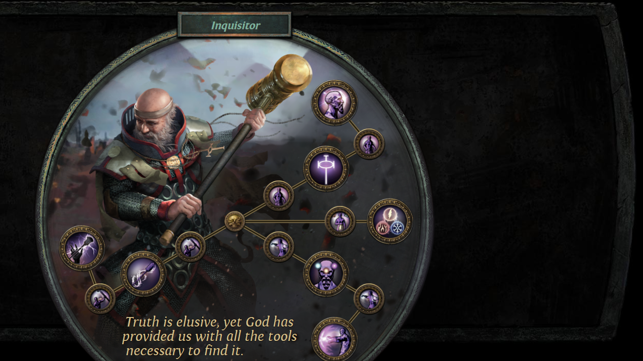
Inquisitor RF
Righteous Fire Inquisitor was the third best early build in Scourge HC SSF and it’s easy to see why.
Powerful defense and serviceable offense combine into a boss obliterator with a very safe playstyle.
Inquisitor can replenish energy shield and life exceptionally well, making it extremely resilient.
However the playstyle is not for everyone. I don’t enjoy RF so I won’t play it.

Slide 9
Champion, Berserker or Chieftain Spectral Helix
Champion again?
Yes, it’s the best ascendancy in the game.
Spectral Helix offers solid offense and is probably the best attack skill utilizing a melee weapon.
Early on, allocate Resolute Technique.
Once you have serious gear behind you, it’s time to outgrow RT and move into a critical strike build.
Helix is versatile and can be played on different ascendancies too - Berserker (elemental crit) or SSF HC as Chieftain RT.

Slide 10
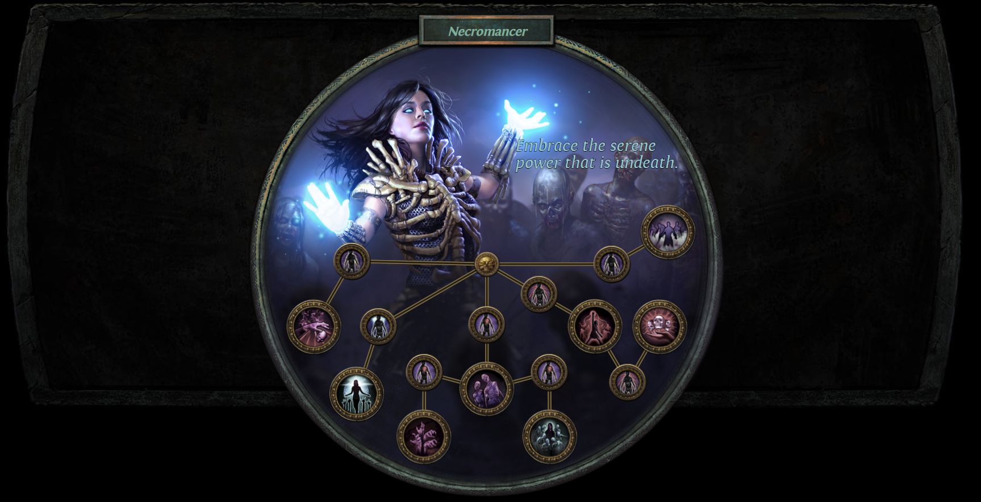
Necromancer Absolution
Sometimes a skill that’s truly awful gets buffed over and over until the point it becomes extremely good.
Seismic Trap was one. Absolution is another.
Awful in 3.15, this skill is now good even without Doryani’s Prototype. That very very rare item makes it even better.
Note: There’s a cryptic patch note line about negative resists. That does not affect Doryani’s in any meaningful way (it’s for resist multipliers)

Slide 11
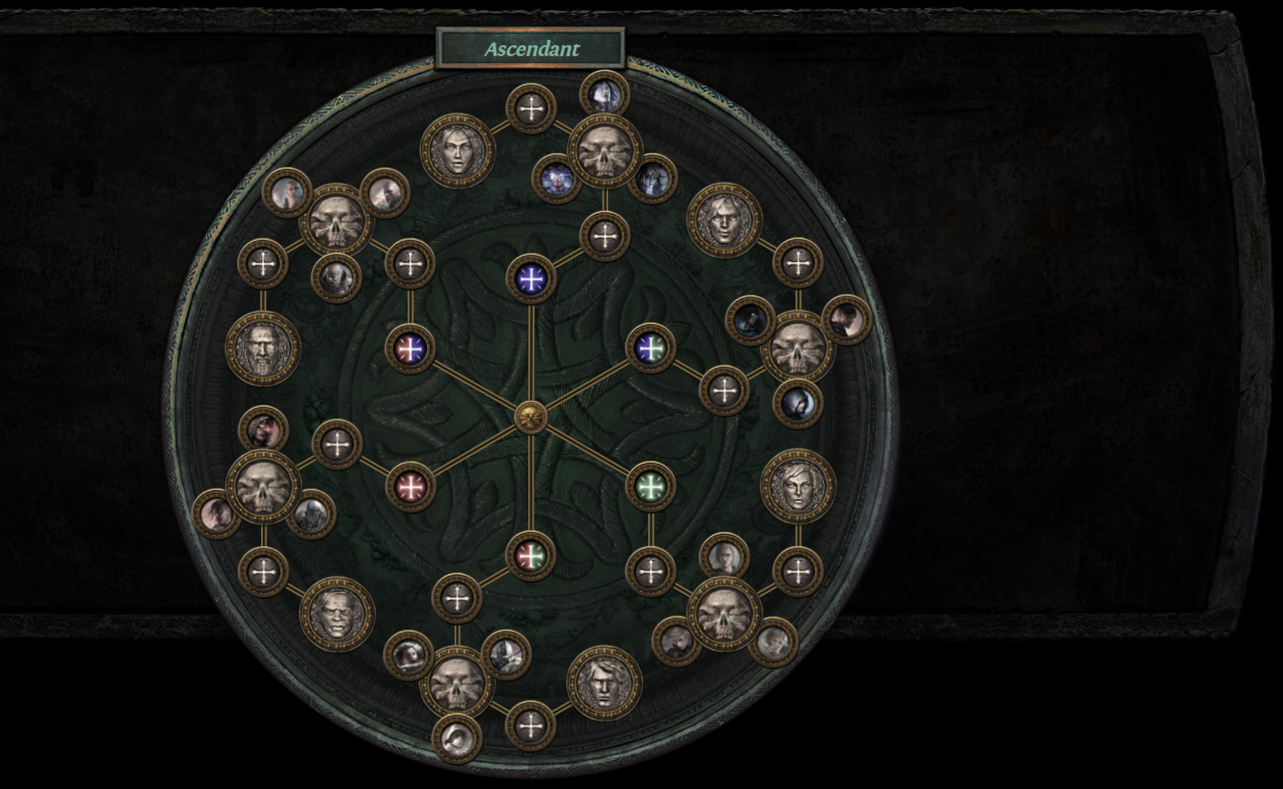
Ascendant Phys DOT
Corrupting Fever is quite good now. Exsanguinate is even better.
Ascendant Necromancer and Gladiator together provide easy capped block. Capped block is good.
This can be played as either selfcast Exsanguinate (buffed in 3.17) or as Spellslinger Exsanguinate (about the same as 3.16)

