Slide 1
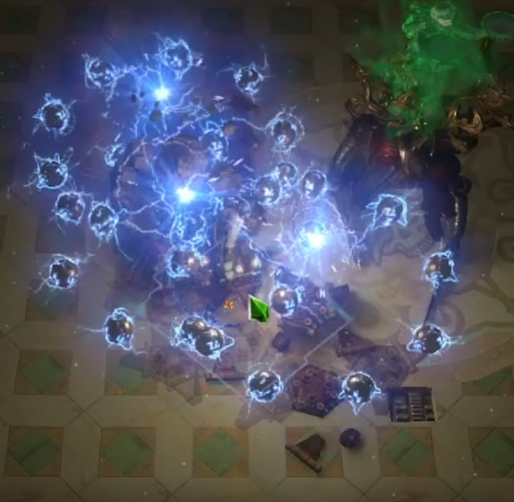
3.17 Lightning Trap Saboteur
Boss and mapping hybrid
Utilizing Lightning Spire Trap as well
Defenses: Grace, Determination, Aura Scaling, Ghost Shroud, and (higher gear levels only) 100% Spell Suppression

Slide 2
Patch Notes Were Kind
Already ‘good enough’ in 3.16
Lightning Trap was buffed 41.4% at level 20
This balances the nerf to Multiple Traps, which this build would have used in 3.16
However Swift Assembly wasn’t nerfed and is now probably superior. We’ll use it instead. Swift allows other sources of +traps to remain good (like the mastery).

Slide 3
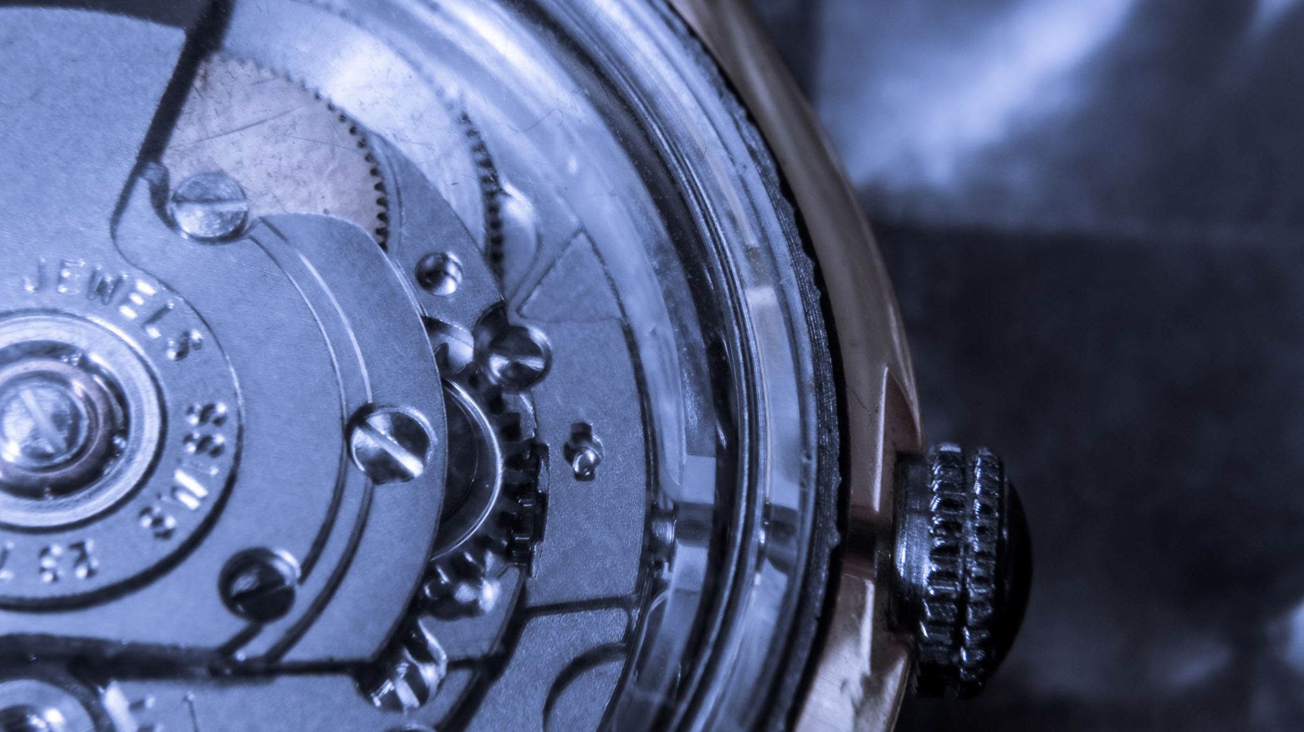
Mechanics
You throw a trap on the ground
Enemy walks on it OR it expires
This causes 8 projectiles to fire
By default they don’t pierce or chain or fork, we’ll fix that on the tree (low gear level) then on gear (high gear level). Pierce will be our solution.
We will scale damage through critical strikes and also shock.
We will augment the serviceable but unspectacular boss damage with Lightning Spire Trap. With Lightning Trap shocking, we can even use Elemental Focus on Lightning Spire trap.

Slide 4
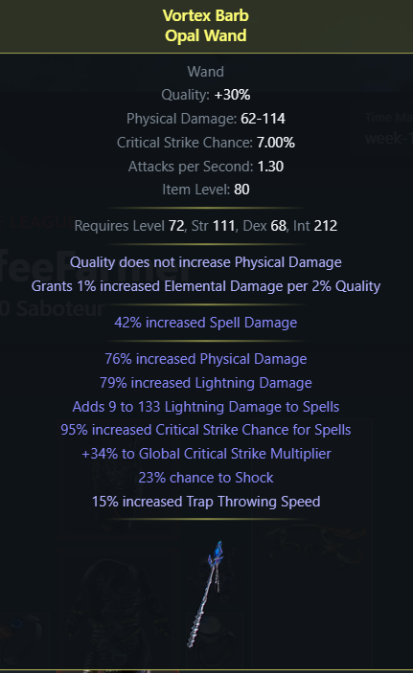
Damage Scaling
We can scale with four main weapon prefixes. Your weapon will be a lot of your damage. You can roll at most one from each category.
+% spell or lightning damage
+ X to Y lightning damage to spells (buffed in 3.17)
+1 to level of lightning spell skill gems (+3 on two-handers)
+1 to level of all spell skill gems (+2 two-handers)
Suffix crit chance is great too, as is crafted trap throw speed.

Slide 5
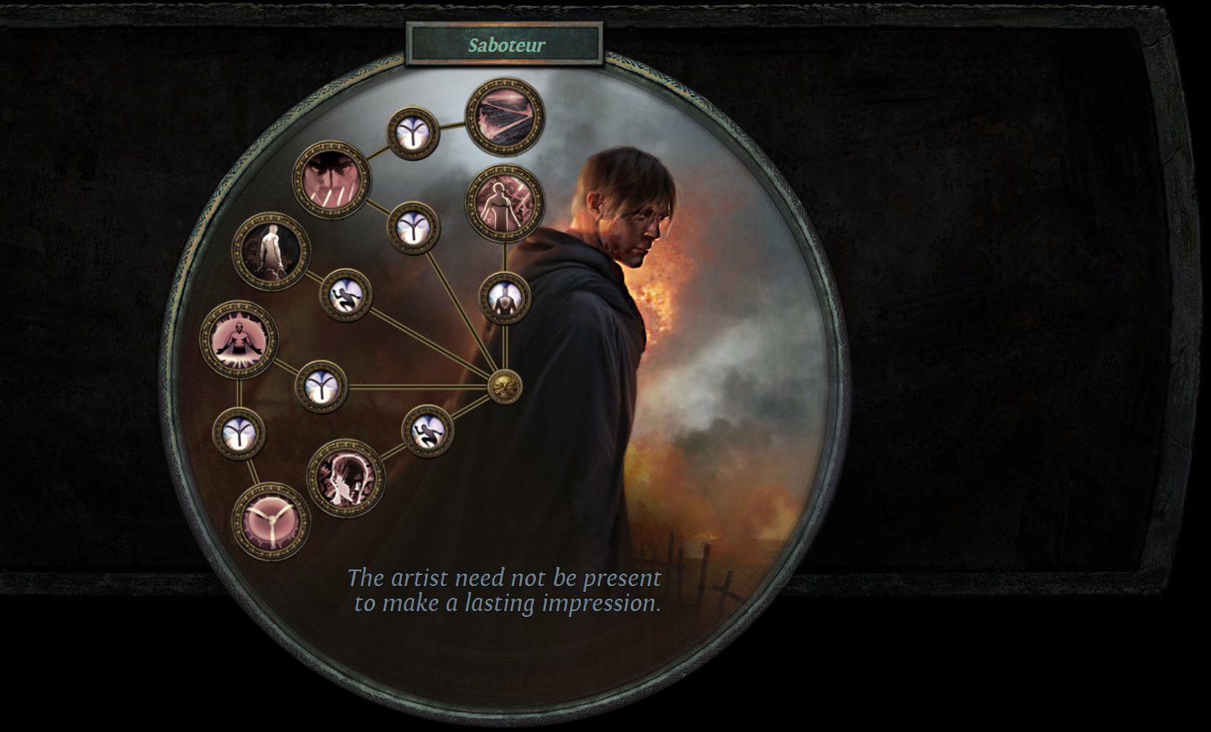
Ascendancy
Pyromanic first. Don’t be like me, I took it last. Oops.
Born in the Shadows and Perfect Crime second and third (Crime for more damage, Shadows for safety)
One of Chain Reaction or Explosives Expert last. Neither is clearly better; try both and stick with your preferred one. I personally prefer Chain Reaction
You could make a good variant of this build in a different Ascendancy – I highly recommend tinkering with the Inquisitor. That’s beyond this video’s scope though.
If you use the Alternating Sceptre option – reassess Explosives Expert. Sceptre makes it worse.

Slide 6
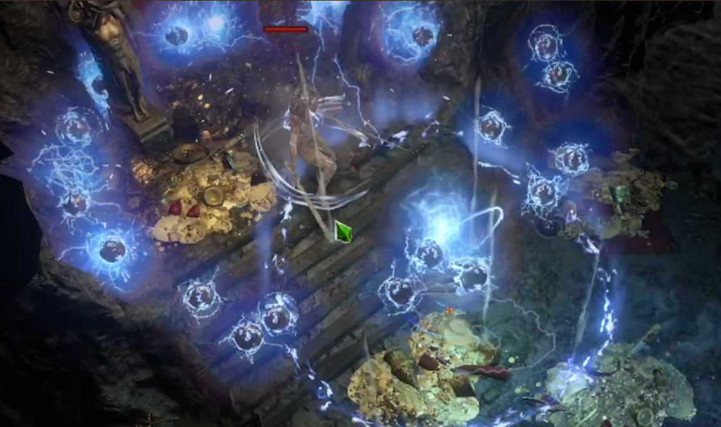
Levelling:
1-11: Use anything. I used Stormblast Mine and hated it.
12: Lightning Trap – Added Lightning Support – Swift Assembly
20: Acquire a good caster wand. Rare Topaz Ring + well-linked wand + Alteration = awesome starter wand
28: Supplement with Lightning Spire Trap (Gravicius reward).
Act 6 until 5L/Tabula: Two skills. Lightning Trap – Added Lightning – Swift – Trap and Mine Damage
Lightning Spire Trap – Advanced Traps Support – Trap and Mine Support – Elemental Focus Support
OPTIONAL: Substitute Added Cold for Added Lightning. Less damage, more freezes. Safer. This is what I did.

Slide 7
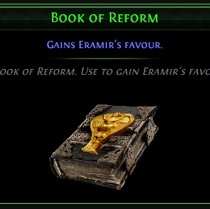
Bandits
Help Alira.
Until high level, 5 mana per second and crit multi is too good to pass up.
The resists free up benchcrafts, allowing more damage mods on your gear.
At high level (92+), you will want to ‘respec to helping Eramir’. Vendor 20 Regret Orbs and an Onyx Amulet.
That cost will be trivial then even if I’m right and regrets are 2-2.5c this league.
This removes Alira’s favour and grants two skill points.

Slide 8
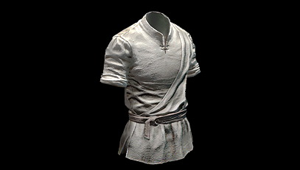
Gem Slots.
This covers the basics. There is flexibility here, we don’t NEED all slots for the core plan.
Chest and Gloves: Dedicated to your main traps. We’ll return to those later.
3L: Arcanist’s Brand – Assassin’s Mark – Wave of Conviction. Cast this brand only for tough and durable enemies. Wave debuffs their lightning resist. AssMark makes you crit more against them.
2L: Cast When Damage Taken (gem level 1), Molten Shell (gem level 4 or 8; 4 costs 20 mana, 8 costs 22, 9 or 10 would cost 25)
Shield (or second weapon): Defensive reservations. Defiance Banner, Grace, Determination. For some time you can’t use all reservations – that’s fine, level them all anyway. But leave Defiance Banner off.
Moveskill: Flame Dash – Faster Casting – Arcane Surge (low level AS)
Utility options: Don’t use all of these! Selfcast Molten Shell – Increased Duration (as well as CWDT; these share cooldown). Golem. Clarity. Decoy Totem.
Skitterbots – Unbound Ailments

Slide 9
Primary Links
Vaal Lightning Trap – Charged Traps – Swift Assembly – Trap and Mine Damage – (Awakened) Added Lightning Support – Inspiration (choose up to 6)
Lightning Spire Trap – Lightning Penetration – Trap and Mine Damage – Inspiration – (Awakened) Added Lightning Support – Elemental Focus – Advanced Traps (choose up to 6)
This build can only use ONE of these as a five or more link until Shaper items are acquired. The other has to be 4 linked.
I suggest using Lightning Spire as your 6L early. 4L lightning traps will kill all trash and shock all non-trash, LST will then clean up the tough stuff.
Empower is good too, but only level 4. Empower 3 is ‘meh’ tier.

Slide 10
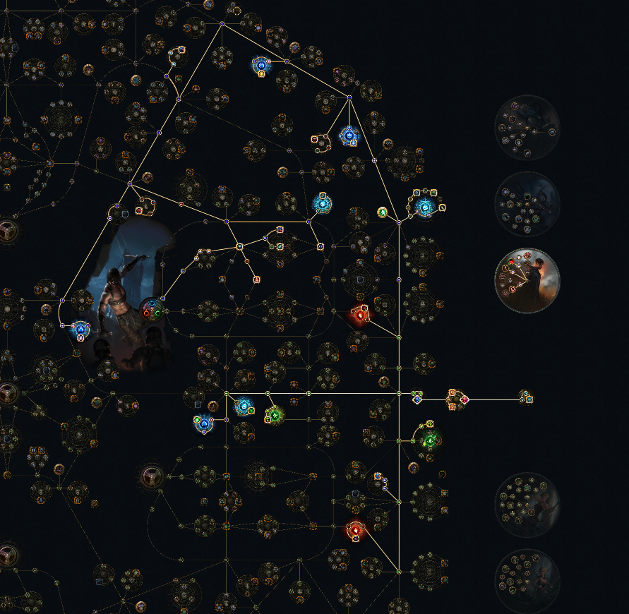
Endgame Reservations
Determination (50%)
Grace (50%)
Skitterbots (35%) linked to Unbound Ailments (x1.2) for 42%
Defiance Banner (10%)
Efficiency: 57% universal, 82% Grace
12% of this is on a cluster jewel. If you can’t afford it all, it’s the Skitterbots that are the weakest link (sorry Skittles)
Optional: Low level Clarity

Slide 11
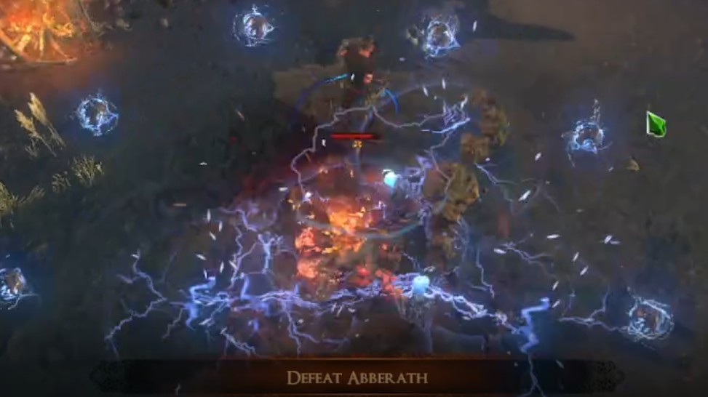
Gearing Through The Acts
Vendor recipe already mentioned.
Rare Topaz + 3L wand + Alteration = 3L wand with the ‘Crackling’ mod, enough lightning damage to get you to Act 8. Add an Orb of Augmentation.
Or use a Sapphire Ring instead of Topaz for cold damage – this will not scale as well but will be strong defensively.
ID rare wands from monster level 51 onwards, you’ll get better wands often. Level 51 flat to spells + bench craft spell damage = great.
Pick up items that already have the right links for you and are not magic. Apply ID scroll if rare, else essences.
Wand and shield in HC. 2 wands in SC.
Benchcrafts + ring implicits for resists.

Slide 12
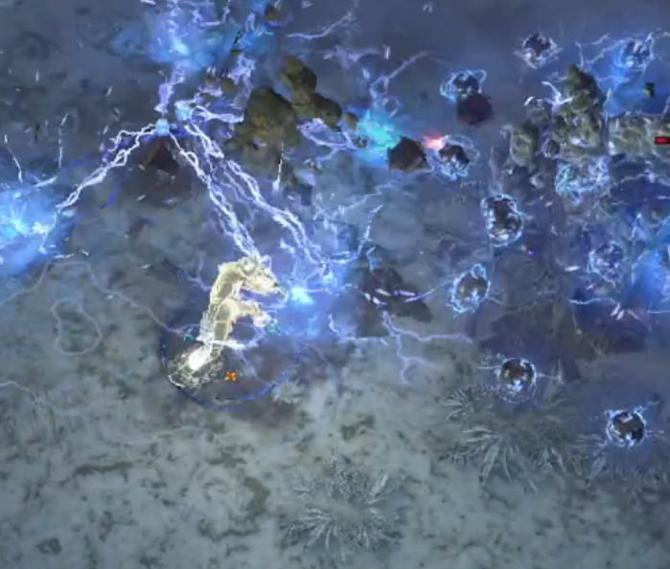
Gearing In Early Maps
T1 flat spell damage is ilvl 74, T2 62. Combine with benchcraft spelldamage%
Topotante’s Incursion wands are AMAZING. Can be used WITH benchcrafted flat damage to spells. These are somewhat accessible now due to Atlas node ‘Artifacts of the Vaal’
Goal is life/resists everywhere.
Spell suppression as you can get it
Atziri’s boots are fantastic. Life, movespeed, suppression. They aren’t common though, and Atziri takes practice to learn.

Slide 13
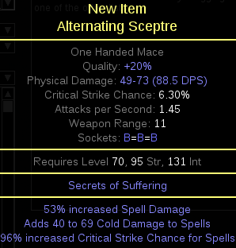
Endgame Options: Alternating Sceptre
Heist exclusive base Alternating Sceptre has Secrets of Suffering on it. This removes your ability to chill, freeze, ignite and shock (your Skitterbots still chill and shock) but grants your crits the ability to inflict Brittle based on your cold damage.
As well as sap, which is neither here nor there.
And Scorch.
Brittle is amazing and this will cap critical strike chance on your Lightning Spire Trap on its own (and this sceptre is not hard to craft)

Slide 14
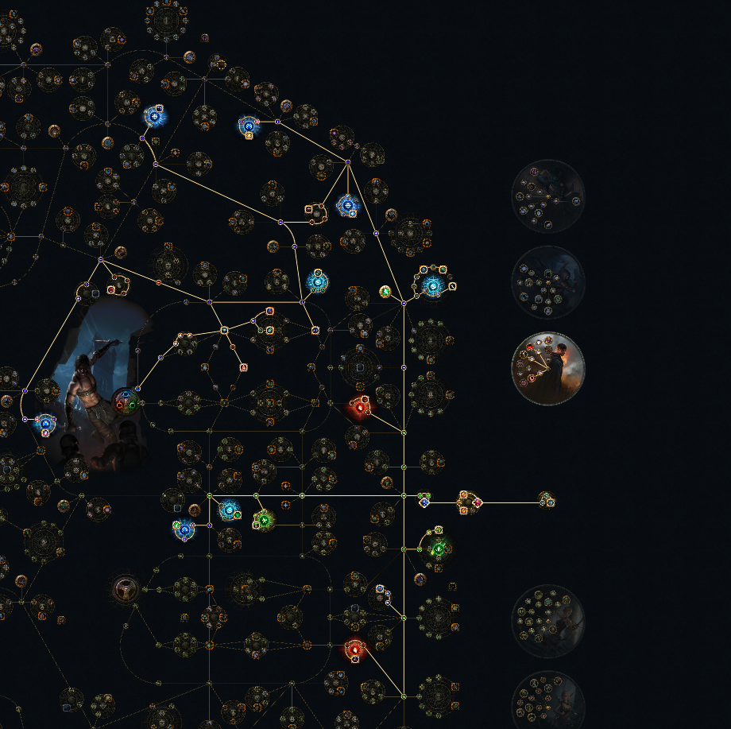
Passive Tree
Key points:
3 Aura clusters because auras are NUTS. With Grace, Determination and Defiance Banner we get a lot of durability from those aura clusters. Ghost Shroud and 500-ish ES adds even more.
The weakest parts of the tree are Throatseeker and Leadership. Take these later in progression.
You path near Spell Suppression nodes. If your gear is close to 100% but not quite there – unspec damage, spec Suppression.
The listed clusters are reasonably easily acquired. Introspection is 1 in 66 alterations on i68 clusters.
You are VERY close to jewels here. Take these when you own quarterway decent jewels.

Slide 15
Ailments
Shock/Ignite: Pyromanic solves these
Corrupted Blood: Flask early (ideally instant life). Jewel becomes important in late red maps.
Traditional Bleed: Flask early. Reroll Vulnerability maps if you remove the flask after solving CB.
Freeze/Chill: Flask. Can be reactive or proactive. Current POB has both (reactive on mana, proactive on granite) – replace one.
Not a fan of Purity of Elements here. I’d rather use Zealotry or Wrath.

Slide 16
Gearing Up In Maps - Weapon
Bad Levelling Gear (T3 flat to spells, bench craft % damage)
Two of: T1 flat to spells, T3+ spell or lightning %, +1 to lightning spells, +1 to all spells
Three of the above, benched trap throw speed
Cerberus Limb
(very defensive)
Incursion mod weapon (Topotante) improved by benchcraft
Very good Topotante weapon

Slide 17
Gearing Up In Maps – Boots
Bad Levelling Gear (25% movespeed, some life/resists)
30% movespeed, spell suppression, life
CORRECTION: DON’T USE Voidwalker (vid is wrong)
(Elevated) Hunter Pierce boots
Atziri’s Step
Enchanted, corrupted Atziri’s Step

Slide 18
Gearing Up In Maps – Chest (Leaving this limited as there are new, unknown options)
Bad Levelling 4 or 5 link (life/resists/suppression)
Shadowstitch
Influnced 6L
Tabula
Skin of the Loyal/Lords
Div card 6L (The Sacrifice, Dapper Prodigy etc)

Slide 19
Gearing Up In Maps – Shield
Bad Levelling Gear (life/resists/suppression)
High evasion, suppression + resists (life a welcome bonus)
…but it also has Shaper T1 reservation efficiency
… but it also has Shaper ‘lifegain on block’
Damage shield. Pure Int, spell damage rolls.
Atziri’s Reflection (allows Coward’s Legacy shenanigans)

Slide 20
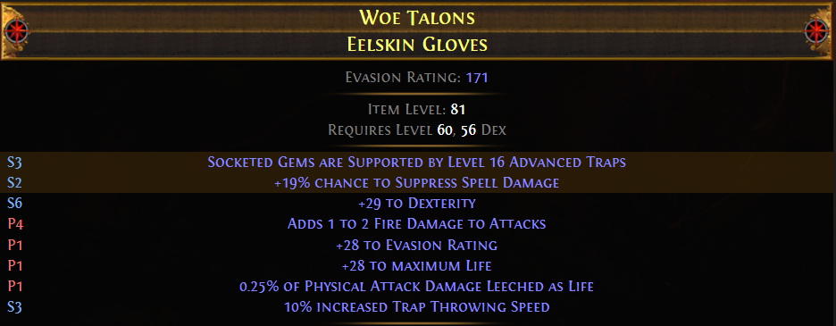
Gearing Up In Maps – Gloves (Also consider Incursion)
Levelling Gear (Spell Suppression, Life and/or Resists – you might use these a while)
Shaper pseudo5L gloves
Shaper 5L with T2+ Spell Suppression & good mods
Shaper 5L with a good Essence mod
Vaal Caress
Slavedriver’s Hand

Slide 21
Gearing Up In Maps – Helm
Levelling Gear (Spell Suppression, Life and/or Resists – you might use these a while)
Enchanted helm, “Lightning Trap Pierces 3 Additional Targets” (Suppression/life/resists)
The enchant AND the Crusader mod
The enchant and excellent mods
Crusader -9% lightning Resist helm
Elevated Crusader -12% lightning resist

Slide 22
Gearing Up In Maps: The Amulet Slot
Guess what? This is being COMPLETELY overhauled.
This will take time to work out.
Best stats are +1 all spell gems, +1 Int gems, +1 Lightning gems, life, and any high tier resist rolls
But there’s lots of other good rolls.
Jorgin’s Tier 2 Talisman bench may actually be excellent here! Now that the +1 gem rolls are no longer influence exclusive, the Talismans will be great.
Anoint Sovereignty

Slide 23
Gearing Up In Maps – Ring and Belt
Levelling Gear (Spell Suppression, Life and/or Resists – you might use these a while)
Opal Rings and Stygian Vises, same stats but better
Crystal Belt with ES and Evasion and more
Mageblood or Headhunter
‘Mark Of The Shaper’
Coward’s Legacy (requires Atziri shield)

Slide 24
Jewels
‘Classic’ jewels are at their best when giving life% and critical strike multiplier. Deft fossils roll good jewels.
Medium clusters you want Set and Forget and Guerilla Tactics on a 4 or 5 passive
Small clusters, you want Introspection which is only on reservation ones. Introspection is ridiculously good as aura effect triple dips on armor and evasion scaling, which then empowers Ghost Shrouds.
Trade league only, look for a Megalomaniac with any two of Introspection, Snowstorm, Guerilla Tactics or Set and Forget.

Slide 25
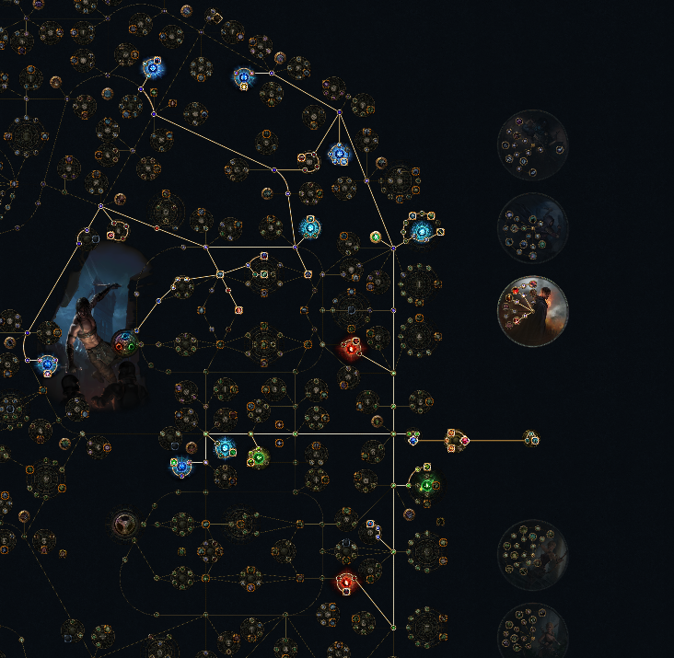
An initial POB
This isn’t something to EXACTLY follow, but to use as a starting point.
This is my character from a 3.16 test run, with a couple of minor changes made.
Eternal Lab was trivial with this (bad) gear. 8 mod red maps were doable, but not trivial.
I’ll post updates after 12 or 15 hours of play. There WILL be changes.
https://pastebin.com/AXfy4vzu

