Slide 1
Budget Crafting
Endgame Chest Armor

Slide 2
3.17 eldritch crafting improves budget crafting by a lot
Whilst almost all mirror tier chest pieces will use the Orb of Dominance (formerly Maven’s Orb), metamods, Harvest and the Awakener’s Orb, those expensive methods aren’t in reach for casual players. And they are as expensive as they were in 3.16 era.
But the new Eldritch crafting allows making far better 2-10 exalt chests than existed in the past.
They also don’t require resources you are unlikely to find in SSF, although SSF players may need to be less picky.

Slide 3
What does a 7-9 exalt chest look like now?
Six linked
Good base (Zodiac Leather, General’s Brigadine, etc)
T1 or T2 life, or T3 life with good spell suppression
The best benchcraft for the build (often 10% of life added as ES)
Eldritch “16% increased Aura Effect”
A useful second Eldritch mod
This competes with 3.16 era options, like a 6-link Hunter chest with T1 attack crit chance and a middling tier life roll made via spamming Harvest ‘Reforge+ Attacks’

Slide 4
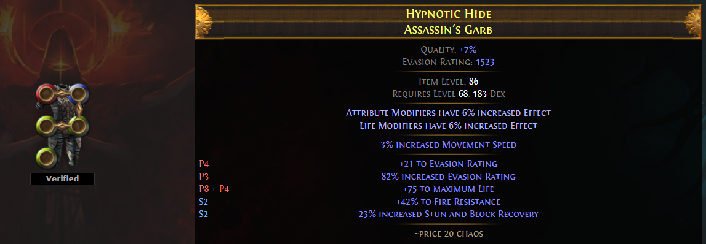
four Starting Points
i86+ Assassin’s Garb or other good base with a good Heist enchant and bad mods/links (cheap, add 2ex for average cost of 6 linking late league)
i86+ six-link on a reasonable base (1ex)
A Heist ‘well rolled’ item that is already (almost) good enough to use (3ex unlinked, 5 linked)
An item that dropped fractured with a reasonable locked mod
Don’t use Harvest enchants.
Don’t lightly use Heist enchants that restrict socket colouring.

Slide 5
Explicit Mods - Prefixes
Are prefixes useable?
If not, it’s often best to make the Exarch dominant (via a bottom tier Ember), then apply Deafening Essences of Greed until you have tier 1.5 life, a good prefix (such as tier 2 life/evasion hybrid) and an empty prefix. Use Eldritch Annuls for a chance to lock in the perfect combination.
You can also scour, then alteration spam for T1 life, then regal then Eldritch Exalt/Annul here.
Benchcraft something good (5-8% life and mana, or 10% of life added as energy shield). Apply this now rather than later (as having 3 prefixes allows using Eldritch Chaos Orbs in later stages without krangling prefixes)

Slide 6
EXPlicit mods - suffixes
This step uses Eldritch Chaos Orbs, Eldritch Exalts and maybe Annuls
Make the Eater dominant then apply Eldritch Chaos Orbs or Annuls while it has at least one awful mod. Eldritch Annul if it has a good mod and a bad mod, Chaos if it has only bad mods.
If the item has a non-zero Dex requirement, spell suppression is the best suffix. Note it’s about 120% more likely to roll on ‘pure dex’ chests than on hybrid – suppression has double mod weighting and there’s fewer total mods in the pool. Even bottom tier suppression is good.
Eldritch Exalts are 1 in 40 to hit T3+ suppression on Dex/Int armor or Str/Dex, and about 1 in 19 on pure Dex.
Goal: Something like T2 Suppression, T3 Cold Resist & one bad mod.
Or if Dex req is 0, two good resists.

Slide 7
Alternative Approach - chaos resist
Different starting point. Dexterity bases only.
Step 1: Deafening Essence of Envy until at least tier 2 spell suppression (average cost 29 essences). Forces T1 chaos resist.
Step 2: Fill suffixes if needed (eldritch exalt rather than bench)
Step 3: Make Exarch dominant, and Eldritch Chaos or Eldritch Annul/Exalt until you have T1 life (average 30 eldritch chaos). If you’ll settle for T2 life, cost to hit is halved.
Step 4: Bench either ’10% life as ES’ or ‘5-8% life and mana’. Eldritch Exalt to fill all other mod slots.

Slide 8
Expensive Alternative - horror essence prefixes
If able, source a Heist enchanted chest with +1 max benchcraft (expensive/rare). Still must be i86, can compromise on base type.
Step 1: Make i86+ item Exarch dominant
Step 2a) Deafening Essence of Horror. If at any point the Horror 15% of phys taken as cold mod is lost, return here.
2b) If 3 prefixes, T1 life, Horror and (unwanted), Eldritch Annul and hope.
2c) If T1 life and Horror are only prefixes, bench 10% life as ES and move to suffixes.
2d) If T1 life not present, Eldritch Annul until only Horror prefix remains (return to 2a if you lose it). Then Eldritch Exalt chasing T1 life
Rough cost estimate: 25 each of Horror Essence, Eldritch Annul & Exalt, just for prefixes.

Slide 9
Searing Exarch Implicit
For most builds, “X% increased effect of non-curse auras from your skills” is the best mod. We will focus on getting Exceptional tier (15-16%) of that mod. You can brave RNG to go single (18%) or double elevated (20%) at a higher cost.
Start by spamming second bottom tier Embers until you hit 11-12% aura effect (average cost 50 Greater Eldritch Ember, 100c)
Very low (<5 ex) budget: Stop here. Else continue.
Apply Exceptional Ichors until you have a not-terrible Eater mod. Doesn’t need to be a mod you personally would use, but roll over useless ones no one wants.
Apply Orb of Conflict until one of two things happens – you hit the double elevated version of the Eater mod (in this case, sell the item and start over; this is why you used an OK mod), or, much more likely, you hit Exceptional tier on the Exarch mod.
Avg cost of step: 60 Greater Eldritch Embers, 5 Conflict, 2 Exceptional Ichor

Slide 10
Eater of worlds implicit
Super straightforward here
Apply Grand or Exceptional Ichors until you are content with the second implicit. Don’t go for perfect here, this is a budget chest, but do roll over things that offer nothing to your build.
OR, apply Greater Ichors until you get the perfect implicit. This is the best choice if you need a specific mod to hit a certain gear threshold, e.g. +% all elemental resists or +% spellblock.
Higher budget option: Spam Grand Ichors until perfect.
Apply Blessed Orbs until both mods are perfectly rolled.

