Slide 1
3.18 wishlist

Slide 2
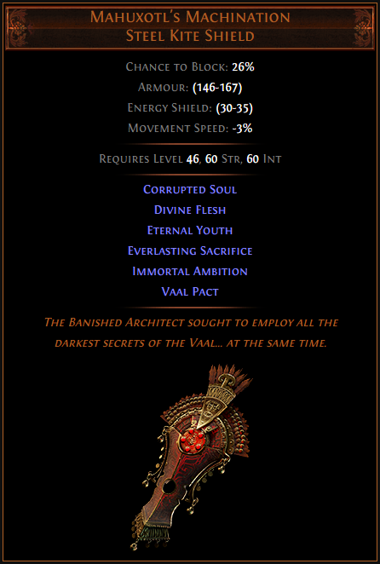
Ultimatum Unique Availability
Problem: Some very interesting uniques are linked to the currently unavailable Ultimatum content. This is being reworked, and not currently ready.
Solution: Either repeat what was done in Delve, where Incursion and Bestiary unique items were added via a Reliquary Key – or temporarily add these to carefully chosen other content.
I’d like them in Maven’s Invitations, with Hateforge available only from The Feared.
But I’d be fine with other means.

Slide 3
A Fix For Fortify
Problem: Fortification stacks are not available when fighting monsters with high Ailment Threshold. The monsters you most need Fortification stacks against are usually bosses – who have high Ailment Threshold. This devalues Fortify, makes the Champion Fortify nodes better than intended and encourages keeping a trash monster alive as a Fortify battery while fighting bosses.
Solution: When you hit a monster with an Ailment Threshold higher than that of Igna Phoenix (rogue exile with 2.6 million HP and equal ailment threshold in tier 16 maps), Fortify calculations treat its ailment threshold is treated as equal to what Igna Phoenix would have at that monster level and monster rarity.

Slide 4
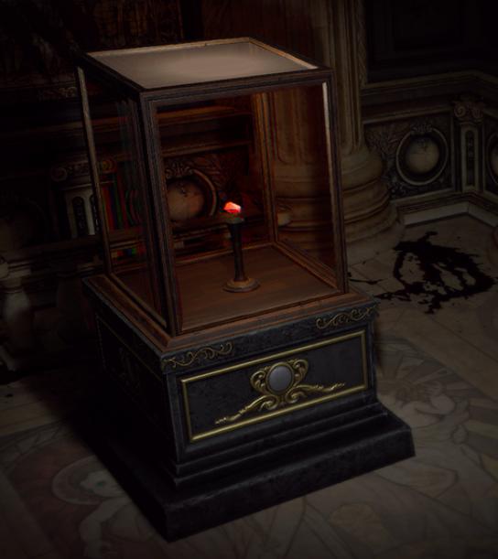
New Sources For Heist Loot
Every league has exclusive loot you (almost) can’t get elsewhere.
Example, Ritual has Blizzard Crown type bases and uniques.
Problem: Heist just has too many of these making it feel mandatory, and a lot of them are ultra-rare.
Proposed Solution:
1) Keep Dying Anguish in good maps
2) Give Maven’s Invitation: The Atlas a modest chance to drop a Heist curio reward.
Proposed numbers (assumes rare invite): 5% replica unique, 5% experimented base, 5% enchanted chest, 5% enchanted weapon, 5% alt-quality gem
Keep Heist the BEST place to get these. Blueprints still are the only place that let you choose between five rewards, and the only place to get trinkets and curio replacement unique items.

Slide 5
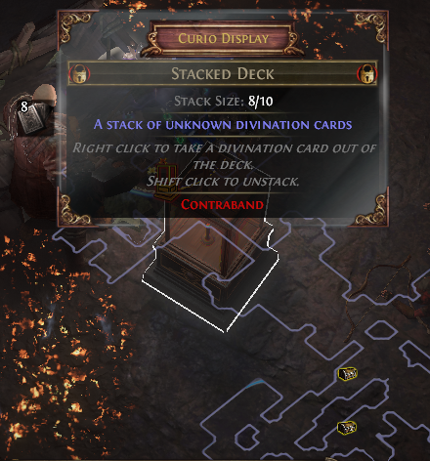
Stacked Decks
Problem: Stacked Decks have too much impact on the trade league economy in the first 96 hours. Most first boss kills come from access tokens (e.g. Maze of the Minotaur maps) sourced from divination cards that come from stacked decks.
Solution: Stacked Decks cannot generate a card until one of these conditions is met:
1) The card has been found in its intended drop location(s) at least 10 times
2) The league is 96 hours old
This preserves the functionality of Stacked Decks mid league and late league, when they are fun.

Slide 6
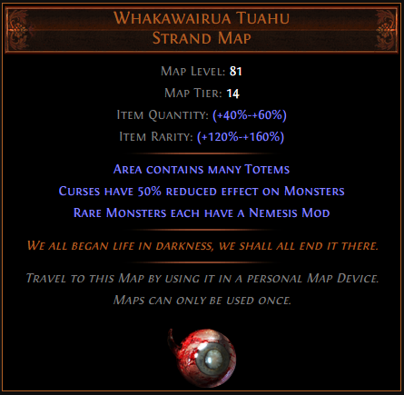
Unique Map Rotation
Problem: The same unique maps have been on the Atlas since almost forever, with only three changes over the years (HOGM and Perandus Manor off, Machinarium on). This means Beachhead, the four ‘lesser’ Synth maps and any new maps don’t get a chance to shine.
Solution: Change is as good as a holiday. Shake them up a little. Remove five unique maps from the Atlas and replace them with five others.
Probably best to keep HOGM off the atlas though…

Slide 7
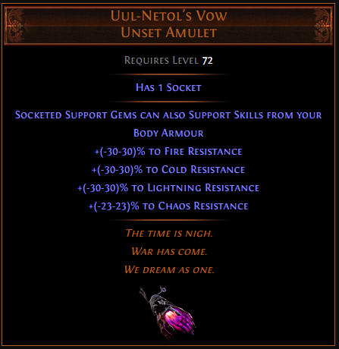
A Reason To Equip Non-Omni Amulets
Crystallized Omniscience obsoletes all rares and all former chase uniques (on builds that can use it)
Leadership’s Price, Uul-Netol’s Vow, Aul’s Uprising, +2 rare amulets – none are worth considering on elemental builds that scale hit damage.
Making Omni rarer doesn’t change this. Even if it is Saviour rarity (the Saviour appears rarer than even a specific Aul’s Uprising is).
Unless it’s put at a rarity akin to that of specific 2 or 3 mod combinations on Watcher’s Eyes or Precursor’s Emblems. At that point the item practically doesn’t exist.

Slide 8
A Limited Future For Archnemesis
I liked the fights and hated the inventory tetris games.
Keep the former, ditch the latter.
Remove Archnem entirely from rollable maps (no 8%).
Add two unique maps dedicated to it.
One would drop like candy (Wurm’s Molt rarity) and would have four Archnemesis encounters with lower tier Archnemeses. At each of four pillars you could choose between three Archnemesis mods.
The other map would be far rarer (Shavronne’s Wrappings tier) and have six Archnemeses, with two of Innocence, Kitava and Treant guaranteed.
These could be on or off the Atlas in any given league.

Slide 9
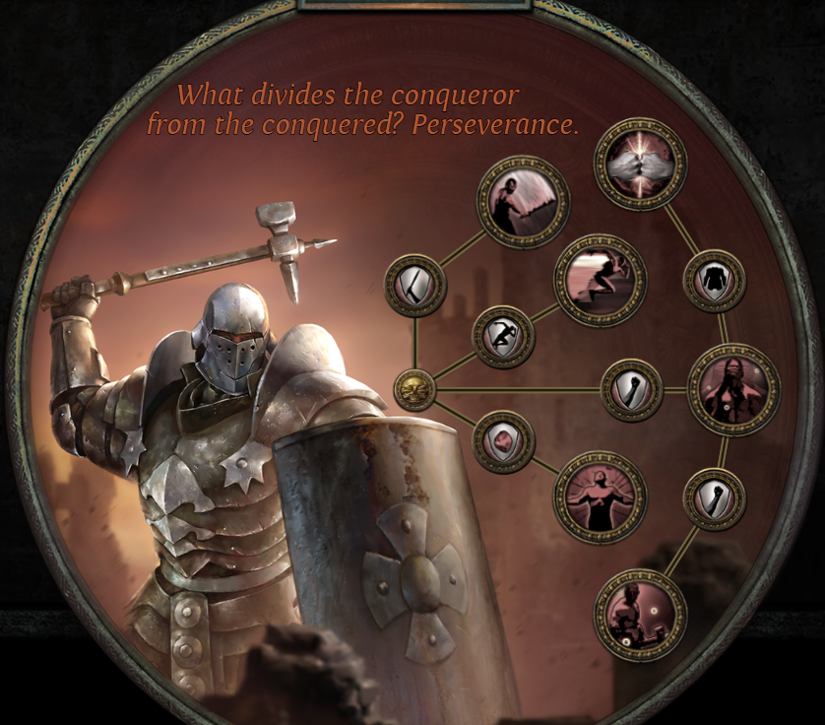
A Reason To Play Juggernaut
Worse offensively than Champion, as it should be.
Worse defensively than Champion. 30% aura effect and free Defiance Banner roughly matches Jugg’s Endurance Charge based defenses, but Champion gets more and Jugg does not.
Solution:
Give all the Jugg notables some amount of flat HP.
Add some (non-Ascendancy) sources that reward endurance charges with damage. Frenzy and Power charges both have these. These ‘sort of’ exist but grant fire damage in small amounts and aren’t good enough to use.

Slide 10
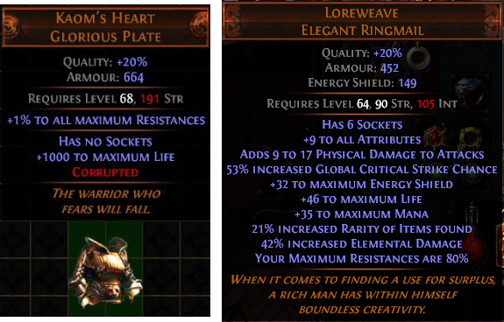
Bring Back Old Favorites
Some items were nerfed for very good reasons… in a different era of the game.
Then, the game got power crept past the old legacy items.
Kaom’s Heart was iconic in an era where Cast When Damage Taken didn’t exist. Legacy Kaom’s would be solid but unspectacular today. Make it Tier 1 rarity (up from the present Tier 2) and restore its old glory.
Same for 80% Loreweave, which was powerful in an era where max resists were harder to increase.
These are two iconic items of POE’s past I’d consider safe to bring back.

Slide 11
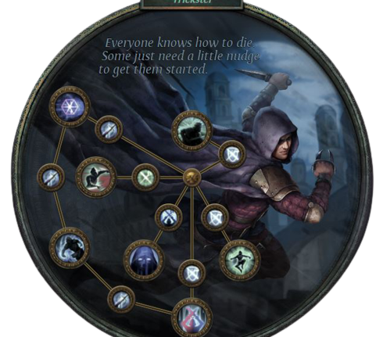
A Reason To Play Trickster
This one is harder to fix, as Trickster’s identity – ‘DOT master’ – is shared with many other ascendancies.
Straight buffs to Trickster would just change the problem as players would abandon other DOT-oriented ascendancies. There’s too many DOT-oriented ascendancies.
I had an idea for a different identity for Trickster that I posted a few months back, playing up Harness the Void and making Trickster the elemental conversion ascendancy. The ‘trickster’ concept then comes up in you not knowing what type of damage to prepare for.
The key though is the need for a new identity, whether it is my idea or not.

