Slide 1
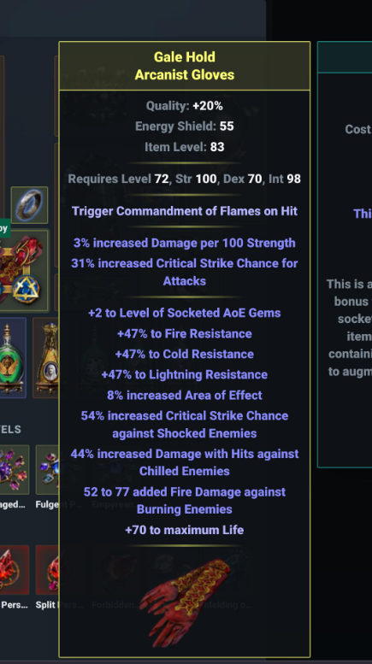
How Was It Crafted?
Episode 1: Sentinel League 3.18
Triple Incursion Mod, Single Veiled Mod
Budget: Around 25 Exalts
Lower Budget Alternatives Possible

Slide 2
What Makes Up These Gloves?
Suffix: Incursion hybrid cold res, damage to chilled. Source: Drop only.
Suffix: Incursion hybrid lightning res, crit v shock. Source: Drop only.
Suffix: Incursion hybrid fire res, damage to burning. Source: Drop only.
Prefix: Veiled AOE (+2/8% hybrid). Sources: Aisling Unveil, Veiled Chaos Orb, Drop.
Prefix: Bench Life.
Implicit: 31% attack crit (Grand Exarch)
Implicit: 3% damage per 100 Str (Lesser Eater)
Ask yourself a question: Which of these are HARDEST to get? Let’s get those first.

Slide 3
Incursion Mod Reminder
The lightning Incursion suffix can be changed into the fire version by Harvest “Change a modifier that grants a lightning resist into a similar tier fire resist mod”.
This always works.
Same applies for the other combinations.

Slide 4
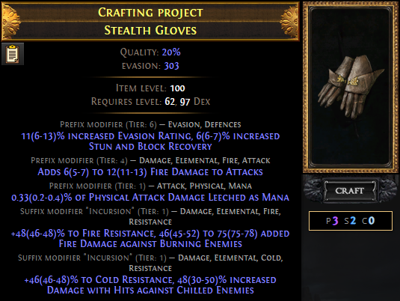
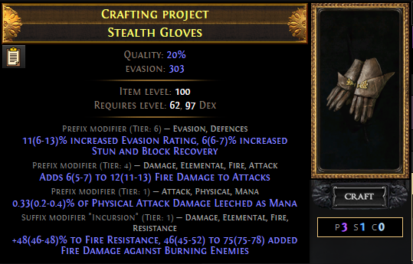
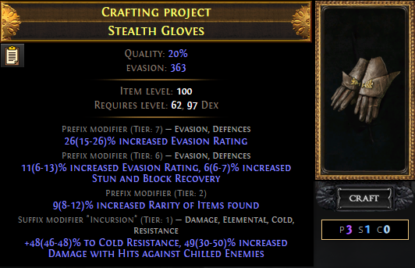
Incursion Mods: Getting 2
There are no ways to add these later, so we’ll get them first.
In any other league, you would be capped at ONE of these on an item. But Recombinators break many checks and balances on crafting.
Start with one-suffix incursion gloves. These drop, or can be made by risky annuls on multi-suffix incursion gloves.
Benchcraft the same non-resist mod on each. Recombine.
44% to win. 5% to lose both mods. 51% to lose one.
44%

Slide 5
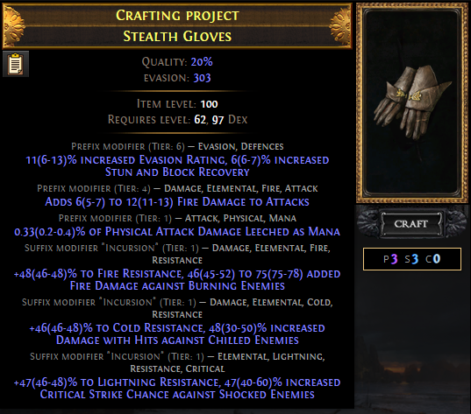
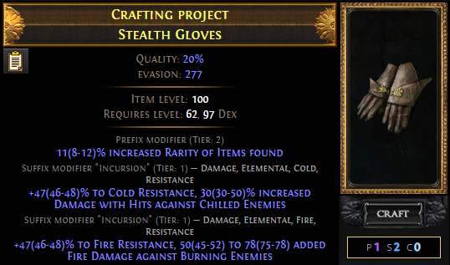
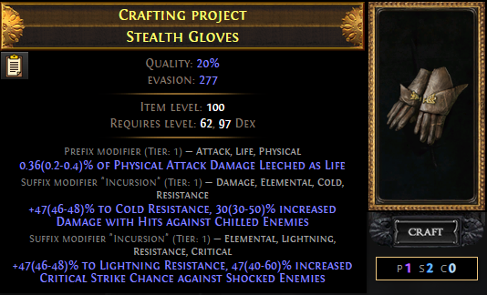
Incursion Mods: 3 On One Item
Same process, but you start with TWO items that each have TWO incursion mods.
However, this time DO NOT benchcraft an additional mod like Dexterity.
Chance to hit: 35%. 50% to get a 2 incursion mod item back, half the ingredients needed to try again.
35%

Slide 6
Fork In The Road
So far, nothing too expensive.
That’s about to change.
Polish those exalts, it’s time for a 2 exalt step that’s 70% to fail each time.
If that’s too much for your budget, all you need to sacrifice is one mod – the veiled AOE gems/AOE hybrid mod.
We’ll cover the higher budget approach first, then come back to the cheaper option, then return to look at implicits which both gloves will need.

Slide 7
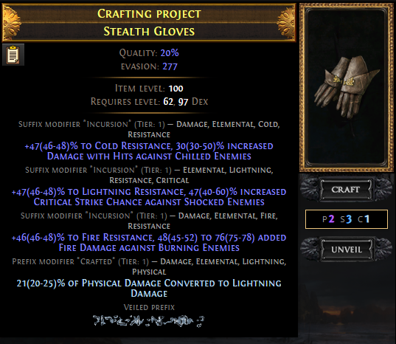
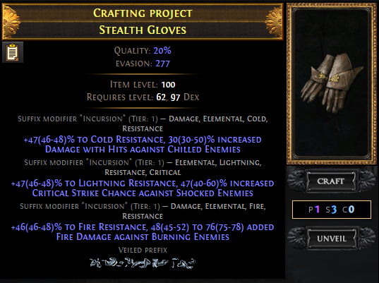
Veiled Mod Reminder
Before unveiling a mod on an item, benchcraft a mod that shares a modgroup with an undesired veiled mod. This bans some unwanted mods.
For glove prefixes, you should always block physical to elemental conversion.
Almost doubles your chance to hit that AOE mod!

Slide 8
‘Suffixes Cannot Be Changed’ + Veiled Chaos Orb or Aisling Unveil: both can work, re-metamod on fail

Slide 9
Dealing With The Six Mod Case
One time in twelve, veiled chaos orbs will roll 6 mods. This is bad. It prevents recrafting Suffixes Can’t Be Changed.
If we aren’t happy with the item at this point, we can use Harvest “Reforge an item, keeping all suffixes”.
This has an 11 in 12 chance to fix the problem.
If not – it’s time for another of the same Harvest craft.

Slide 10
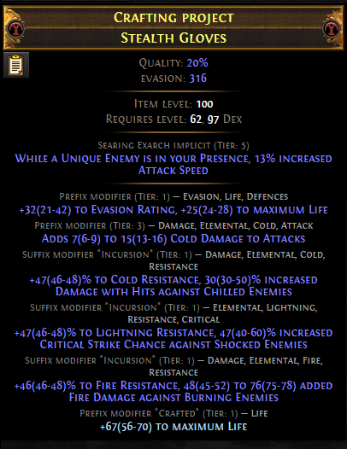
The Budget Alternative
This item will be an Eldritch item eventually.
Make the item Exarch dominant (via use of any Eldritch Ember)
Apply Eldritch Chaos Orbs until the item is ‘good’
This approach cannot ever get veiled mods.

Slide 11
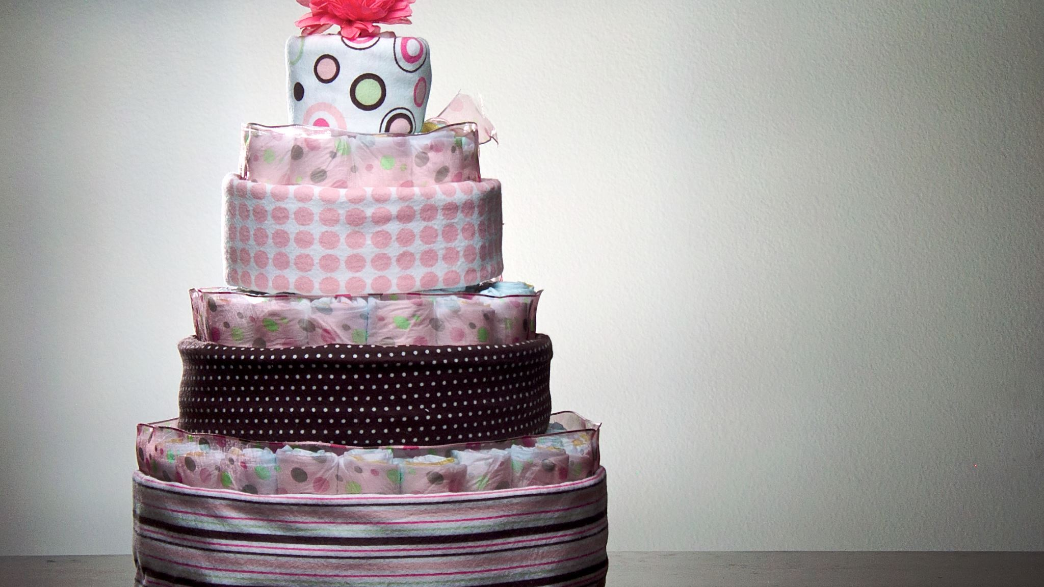
Implicits The Final Layer
For low tier mods as seen on the original item, this is really easy.
3.18 made Grand embers and ichors cheap. Not free, but an exalt buys 50 or so.
Use those frivolously until content with the results.
For Exceptional tier (not needed on this item), it’s best to roll the right mod at Grand tier, then use one Exceptional ember/ichor of the other type, then spam Orbs of Conflict. Average cost: 2 Conflicts, 1 Exceptional.
Exquisite tier is the same, but typically 6 Conflicts.
Perfect tier, many more. Perhaps 16? Odds not known. I tried to research this last league but simply couldn’t buy enough Conflicts.

