Slide 1
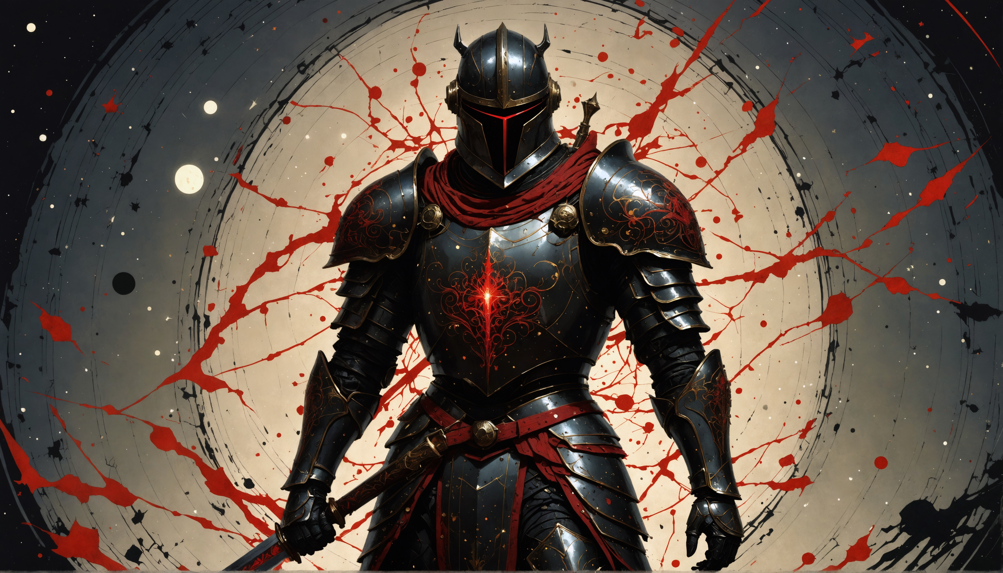
3.25 November Event Ideas

Slide 2
POE 2 has been delayed until 06-Dec-2024. This makes 3.25 one of the longest leagues ever. In the past GGG have run events like Endless Heist, Atlas Invasion and Delirium Everywhere alongside long leauges.

Slide 3
Players are free to decide – keep playing the league if it’s still fun, move on to other games for a while, or jump into one or more of the events. GGG probably don’t want to run events that take a lot of programming. For this reason every idea here is similar to something GGG ran before.

Slide 4
Idea 1: Endless Delve Done Differently
Endless Delve has been a player favorite. You are stuck only in the Delve mines from level 1 and the rules enforce SSF play.
You have unlimited sulphite.

Slide 5
Endless Delve Done Differently
Problem: Endless Delve has been ‘solved’.
Every time it has run, the same ignite builds are overwhelmingly dominant due to a starter unique all players get access to. This item isn’t in the base game.
Solution: Remove the starter uniques.
This creates a new problem (players being too weak to survive the first node). Solve this by letting players START with all 24 passives from quests, instead of getting them every few XP levels.

Slide 6
Endless Delve Done Differently
Endless Delve has a ‘hidden pillar’: Bad Items. Does it need this?
Players have access to comparatively weak items in Endless Delve due to limited access to endgame crafting. This is interesting as a diversion, but… does it have to be this way?
Change: Add the Recombinator to the Delve mines. Allow players unlimited use (no dust, no gold)

Slide 7
Endless Delve Done Differently
Fossil crafting has fallen behind.
Except for a few crafts, fossils aren’t very popular in the base game. They were great when we had 20 leagues less power creep.
Change: Add Sanctified Resonators, Sublime Resonators and Foresight Fossils as semi-chase, chase and chase drops, respectively.
If these are ‘safe’, they could be added to the core game later.

Slide 8
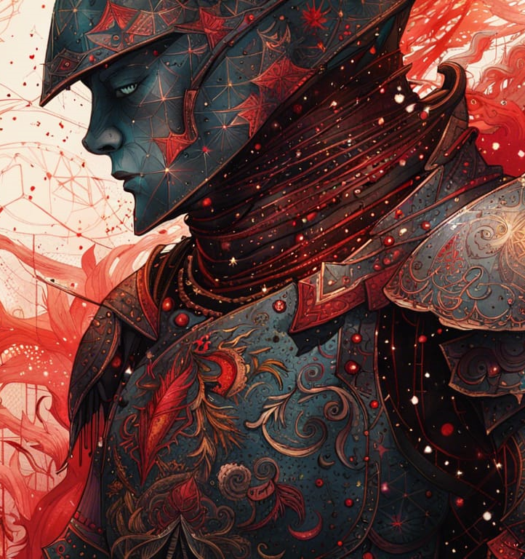
Sanctified Resonator
Like a 5 socket resonator! But one has to be a Sanctified Fossil.
Not available at all outside Delve, ever. Never available in Ruthless.
Found only behind fractured walls from depth 100+, rarely (~0.5%) outside cities and occasionally (~3%) in city biomes.
Functions as a Prime Resonator, but has a Sanctified Fossil effect added on top of the other four resonators.

Slide 9
Sublime Resonator
If this goes core, it’s intended to be chase (Veiled Orb). It may be too good.
Not available at all outside Delve, ever. Never available in Ruthless.
Rarely found behind fractured walls from depth 400+ in city biomes. Occasionally found from bosses.
Functions as a Prime Resonator, but with the added text “Always has maximum (6) modifiers. Biases against rare modifiers are ignored”.
This might be too good. If it is, well, it’s one event only.

Slide 10
Foresight Fossil
If this goes core, it’s also intended to be chase. It’s good, but likely safer than Sublime Resonators.
Not available at all outside Delve, ever. Never available in Ruthless.
Rarely found behind fractured walls from depth 400+ in city biomes. Occasionally found from bosses.
Resonators with a Foresight Fossil function normally, but the post-modification item has foresight, as though a Hinelock was applied to it.

Slide 11
Idea 2: Mini-Patch & Ten Day Fresh Start
There’s not time for 3.26 before POE2.
But sometimes, small changes – new scarabs, etc, shake up the game a lot. And lots of players love a fresh start economy.
Suggestion: Add ten new rare or mythic scarabs that do wild things, in a patch similar to 3.24.2. Add a single new T17 map and a unique drop-anywhere map with a boss aimed at players who find T17s too difficult. Drop it at the usual leaguestart time.

Slide 12
Idea 2: Mini-Patch & Ten Day Fresh Start
Then run a 10 day fresh economy league parented to Settlers league. Once it ends – characters and accounts migrate to Settlers just as you’d migrate out of a private league.
But I’d try something new as well.
For the first weekend, have the new scarabs/T17/unique map and boss only available in the 10 day event.
After that weekend, it goes core.
This is something POE can learn from Last Epoch, where new core game bosses don’t get added to LE’s Standard until they’ve been beaten in the temp leagues.

Slide 13
Idea 2: Mini-Patch & Ten Day Fresh Start
This won’t be 3.26. But face it, we aren’t getting that until late Jan or maybe even Feb.
It is, however, something for the interim.
After all, not all POE1 players will enjoy POE2. It is fundamentally a different game.

Slide 14
Idea 3: Delirium Everywhere Done Well
Delirium Everywhere was an event GGG ran once, during 3.19, that wasn’t well received.
It had major flaws – it wasn’t pitched as a Ruthless-style harder version of the game, but that’s what it was.
It had unpredictable difficulty spikes as well as being much harder than the base game.

Slide 15
Delirium Everywhere: How To Fix It
This might need to be a voided event, as it will drop a very large amount of items once players get rolling.
Although, Affliction league wasn’t voided… so it’s likely OK if parented to Standard. Definitely not OK if parented to Settlers.
Each zone has “Players are X% delirious. X% increased item quantity. X% more item rarity”. X isn’t random. X is the area level.
For this to be successful, the grey mist has to go. It’s miserable. Also, Delirium orbs, Simulacrum splinters and related divination cards and scarabs would be drop-disabled.
Various numbers like cluster jewel drop chance would need thought, and Atlas passives for Delirium should be unavailable.

Slide 16
Idea 4: Group Found Events & Asynchronous Races
GGG tested some awesome tech in March 2023 events… but the events themselves were… questionable. They dialled group play up to 11, and prevented solo progress. Friends aren’t on? You can’t play.
The tech for group found events and asynchronous races hasn’t been used since, which is a pity.
Time to fix that!

Slide 17
Idea 4: Group Found Events & Asynchronous Races
There’s some potential for GGG to run events that capture some of the feel of the popular player run event BPL, where players can organize teams and try to complete a checklist of goals as a group.
For instance – can your group of 20 players complete all four Voidstone bosses in one week? All three Enriched Uber Labs? All seven Uber Pinnacles?
If you can achieve a goal – can you do it faster than other groups of 20?

Slide 18
Idea 4: Group Found Events & Asynchronous Races
For people interested in POE’s racing scene, there’s also plenty of room for time trial style races.
How long does it take your group of 10 players to slay Lycia in the Sanctum? Or Nashta? Or commonly raced to bosses such as 2 voidstones?
The March 2023 tech would be really interesting to see used again. It always felt designed for player-run races.

Slide 19
Idea 4: Group Found Events & Asynchronous Races
Prize structures will determine who the target audience for race events will be.
“First players to X get Y” – is designed for elite players only
“All who X get Y and enter a draw for Z” – more mass appeal, worse for spectators
“All who X enter a draw for Y, first 10 to X also get Z” – a balance of the two.

Slide 20
Summary of ideas: Endless Delve & Recombinators Mini-Patch & Fresh Start Delirium Everywhere Revisited Group Found Events Revisited

